Slide 1
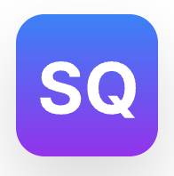
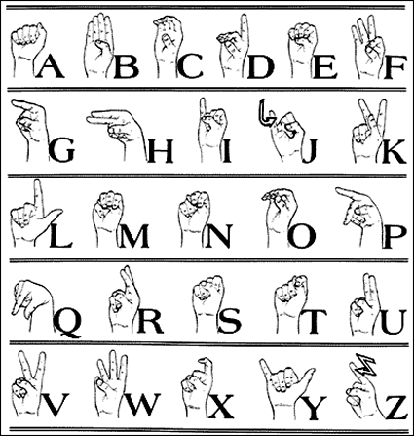
SignQuest
Group 4: Adam Kolodziejczak, Caleb Radbourne, Ethan Gonsalves, Om Sathe
Interactive Quests For Your Hands!

Slide 2

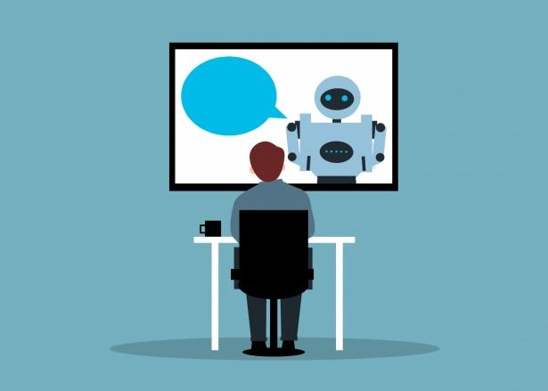

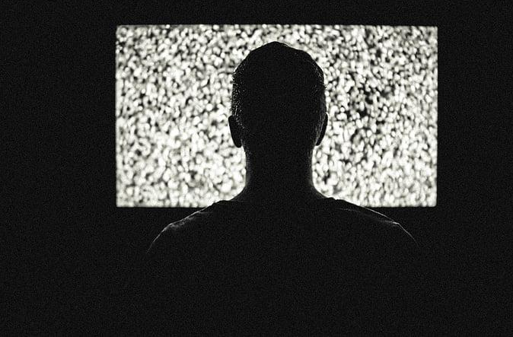
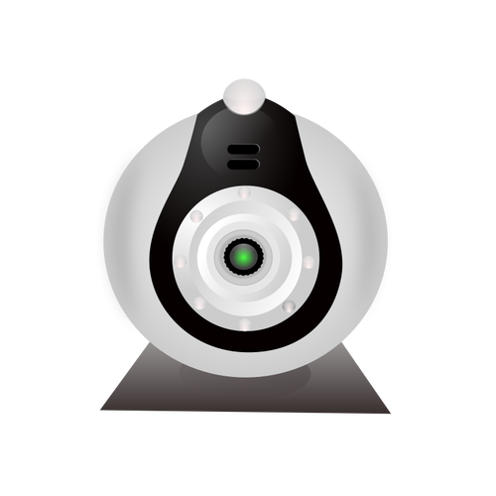
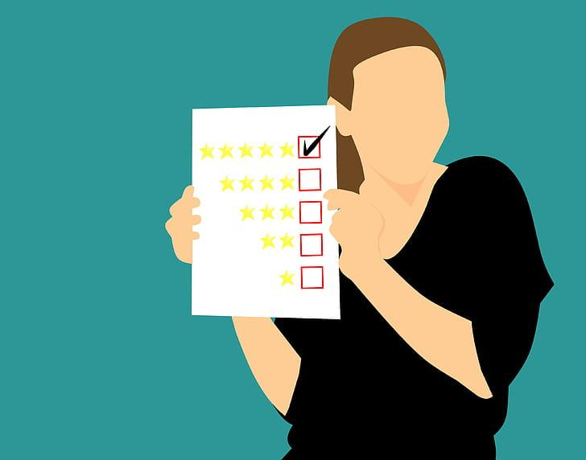

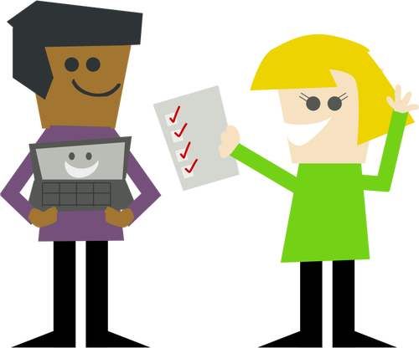

Problem
Motivation
Notes:
Most ASL apps are passive where you use cue cards (people can easily memorize patterns rather than words/meaning and not know if they are correctly doing the sign), (the “watch and repeat trap”) watch videos that could lead to low retention
And most importantly try to learn without feedback, where practice feels alone and
Research shows that interactive game like practice with immediate feedback (FIND WHERE THIS WAS MENTIONED IN CLASS) results in retention. As well as gamification and microlearning leads to better muscle memory (MAKE SURE THIS IS CORRECT MEMORY FROM NOTES) resulting in more accurate actions. Our app will also have live camera for feedback and games (something other apps if anyone just use to process actions not live) and final all learning objectives have the goal on human interactions with some tools directly meant to interact with others.

Slide 3
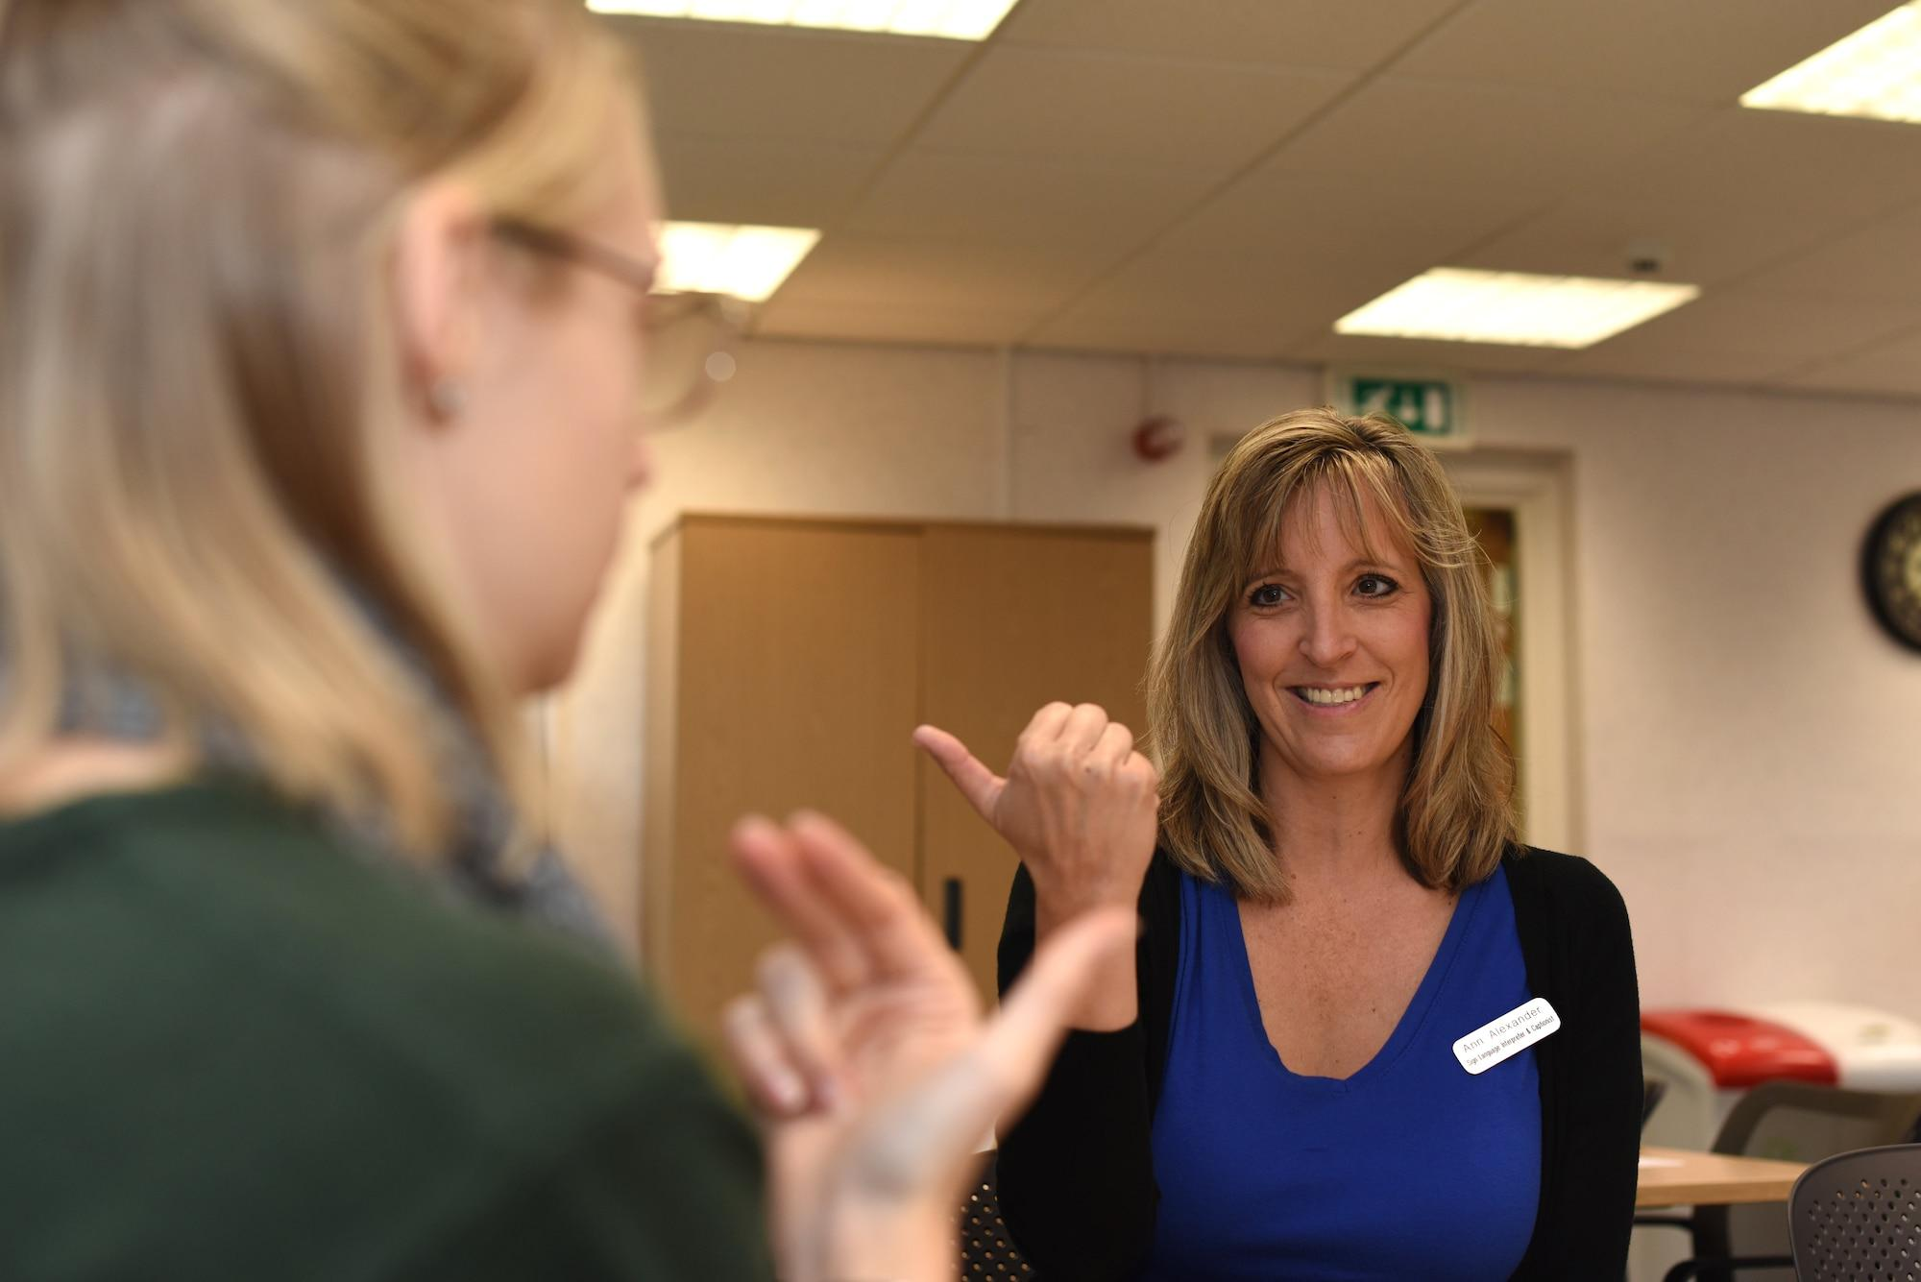
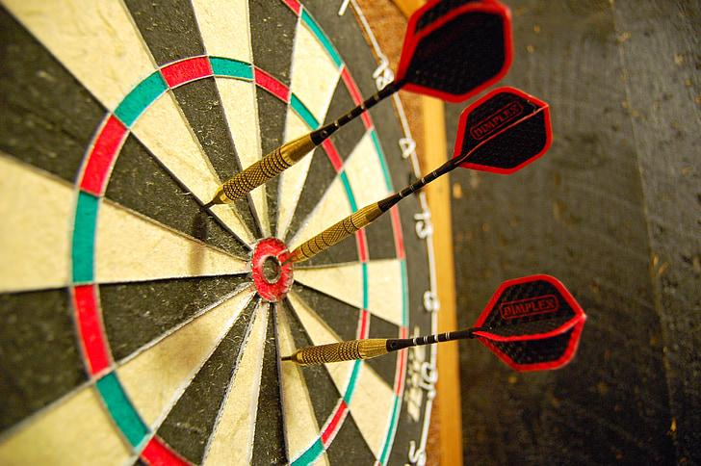
Target Audience Learning Objectives
No to Little ASL Experiences
Students (High School/ Post Secondary)
Self Learners beyond Post Secondary
Accuracy: Produce 100+ ASL signs with 85% accuracy
Form: Correctly execute handshape, orientation, and motion
Fluency: Complete real-world simulations like “Ordering Coffee”
Notes:
Sign Quest has a target user basset of beginners with little to no experience with ASL. This being students or self learners who want to learn more in a interactive way.
With this specific target audience were able to design clear, measurable outcomes. By the end of using Sidequest, these users should correctly perform over 100 signs, maintain proper technique, understand short conversation and achieve at least 85% recognition accuracy in live practice.
Each lesson is delivered as short 5–10 minute microlearning activities to keep practice focused and effective.
ENSURE THESE ARE GOOD AND MEET SMART

Slide 4
What do other similar apps offer?
APP | SignSchool | ASL Dictionary | Lingvo | Duolingo
PURPOSE | ASL learning + Exercises | Sign lookup | ASL lessons | Spoken languages
INTERACTIVITY | Video + Exercises | Visual videos | Lessons + Quizzes + Tools | Gamification language exercises
COST | Free | Low one-time cost | Subscription | Free + subscription offer
BEST USE | Vocabulary | Quick sign search | Structured learning and practice | Surface level spoken languages
Notes:
Ethan’s part

Slide 5
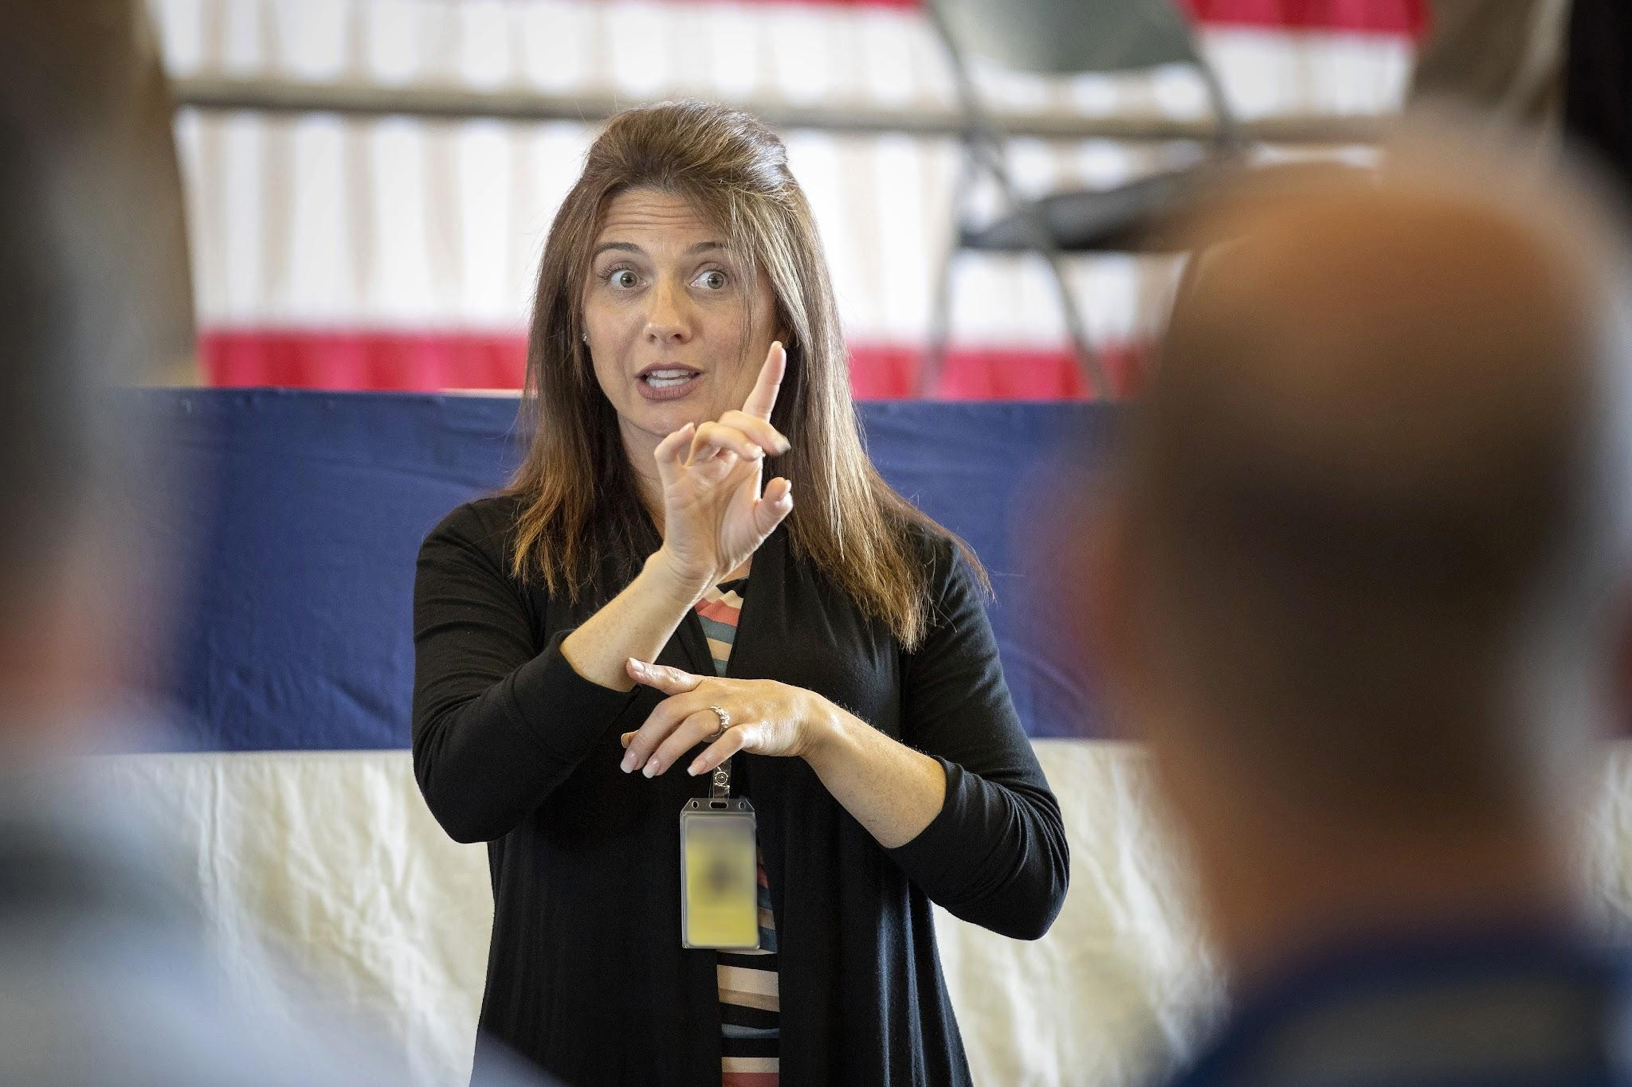
Learning Objects
Lessons
Notes:
SignQuest uses gamification features to help beginners learn American Sign language through many steps such as:
Lessons: Consisting of ……
Dictionary: where users can search by difficulty to find specific words and signs and how they are done
Games:
Translate: Live translation of a person sign language

Slide 6
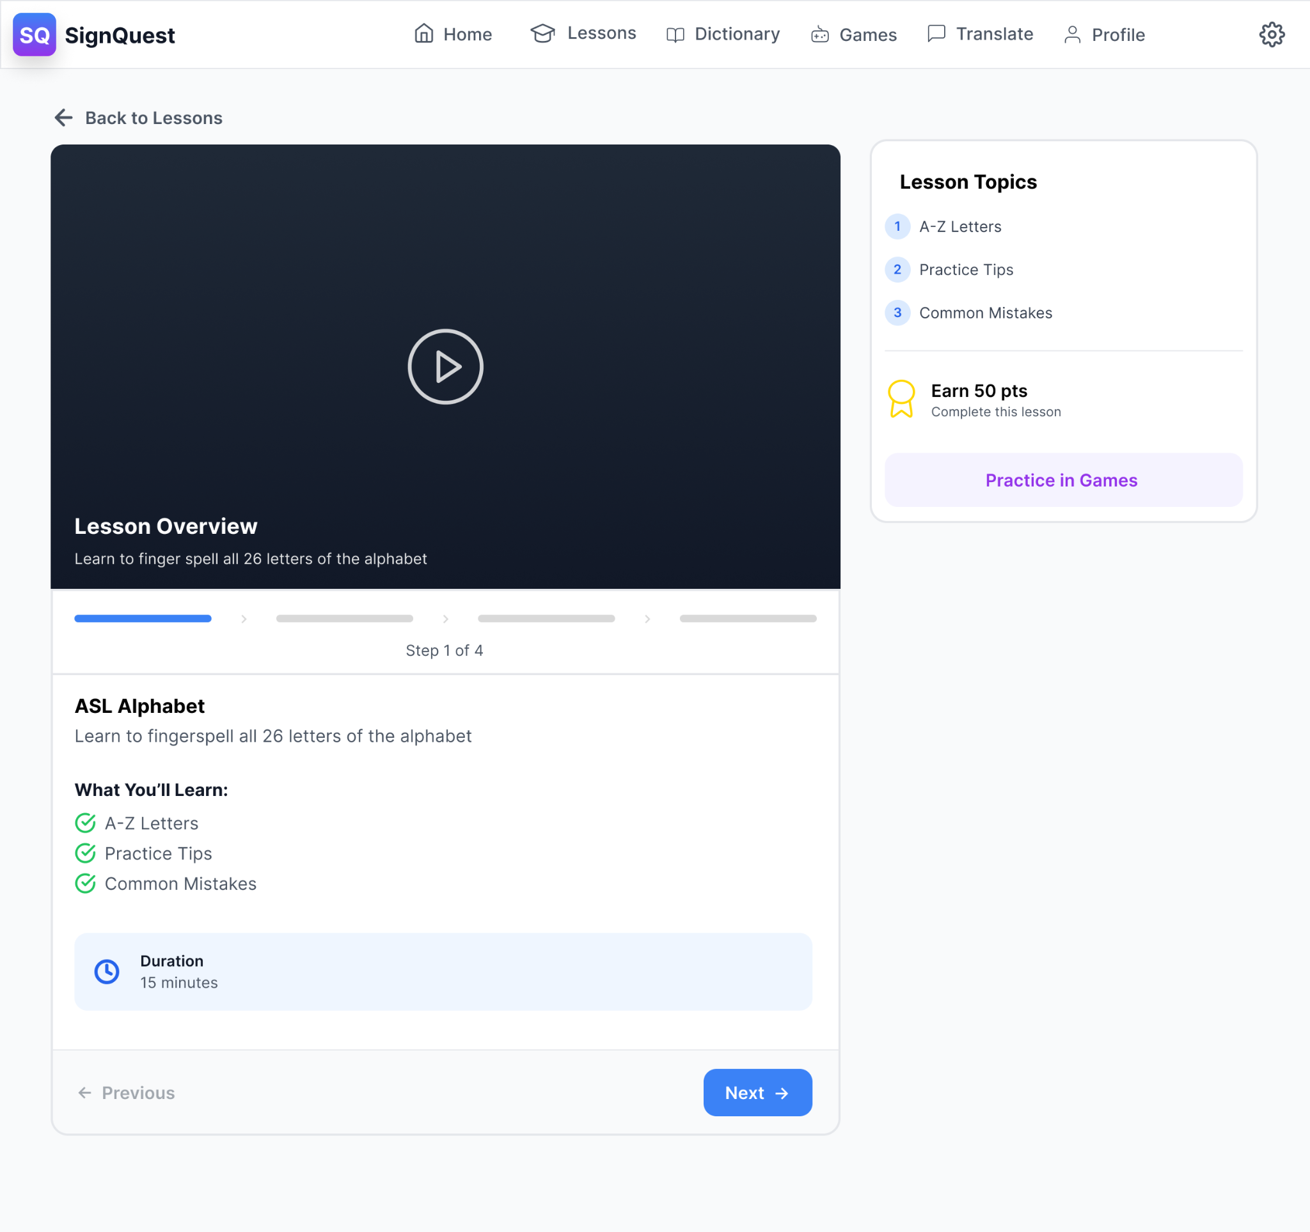
Learning Objects
Lessons
Classroom Style
Notes:
SignQuest uses gamification features to help beginners learn American Sign language through many steps such as:
Lessons: Consisting of ……
Dictionary: where users can search by difficulty to find specific words and signs and how they are done
Games:
Translate: Live translation of a person sign language

Slide 7
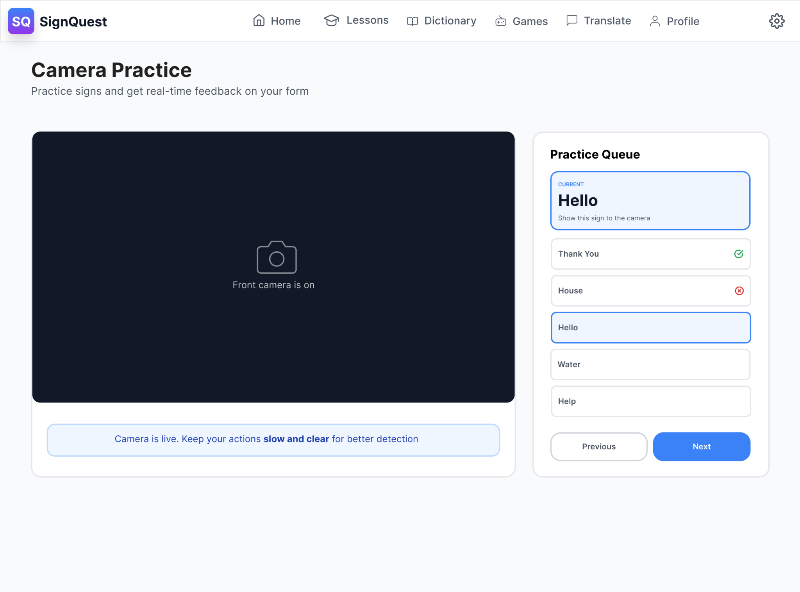
Learning Objects
Lessons
Camera Practice
Notes:
SignQuest uses gamification features to help beginners learn American Sign language through many steps such as:
Lessons: Consisting of ……
Dictionary: where users can search by difficulty to find specific words and signs and how they are done
Games:
Translate: Live translation of a person sign language

Slide 8
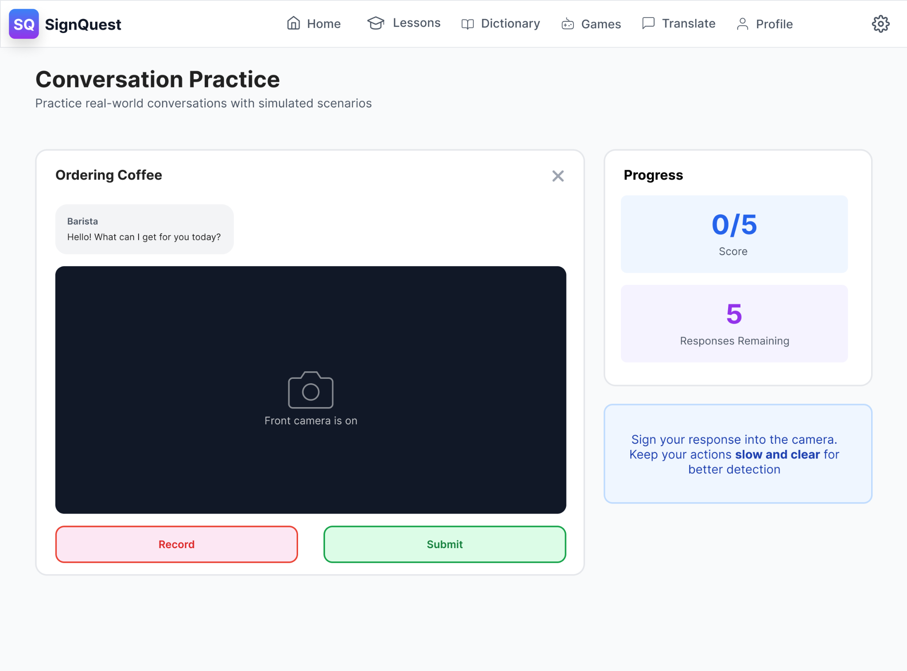
Learning Objects
Lessons
Conversation Practice
Notes:
SignQuest uses gamification features to help beginners learn American Sign language through many steps such as:
Lessons: Consisting of ……
Dictionary: where users can search by difficulty to find specific words and signs and how they are done
Games:
Translate: Live translation of a person sign language

Slide 9
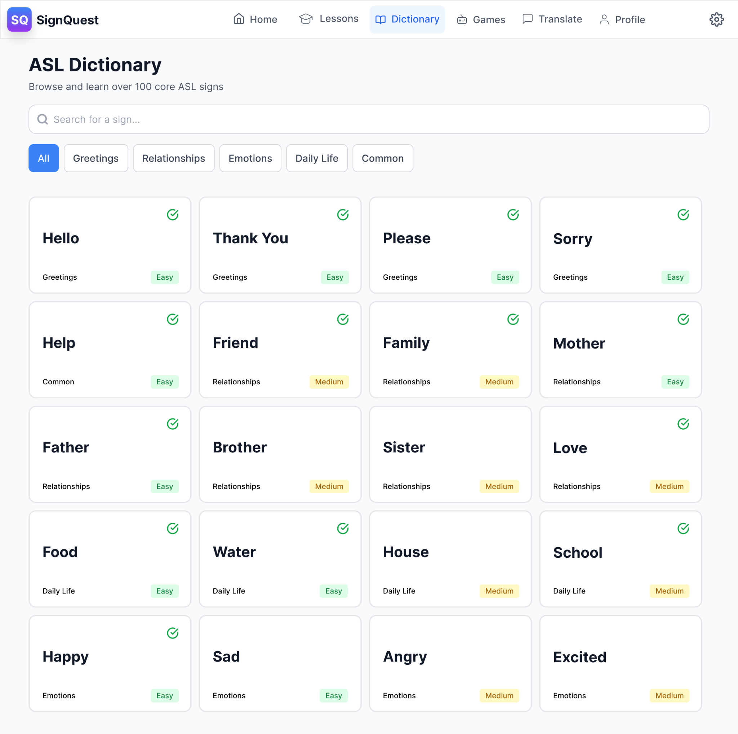
Learning Objects
Dictionary
Lessons
Notes:
SignQuest uses gamification features to help beginners learn American Sign language through many steps such as:
Lessons: Consisting of ……
Dictionary: where users can search by difficulty to find specific words and signs and how they are done
Games:
Translate: Live translation of a person sign language

Slide 10
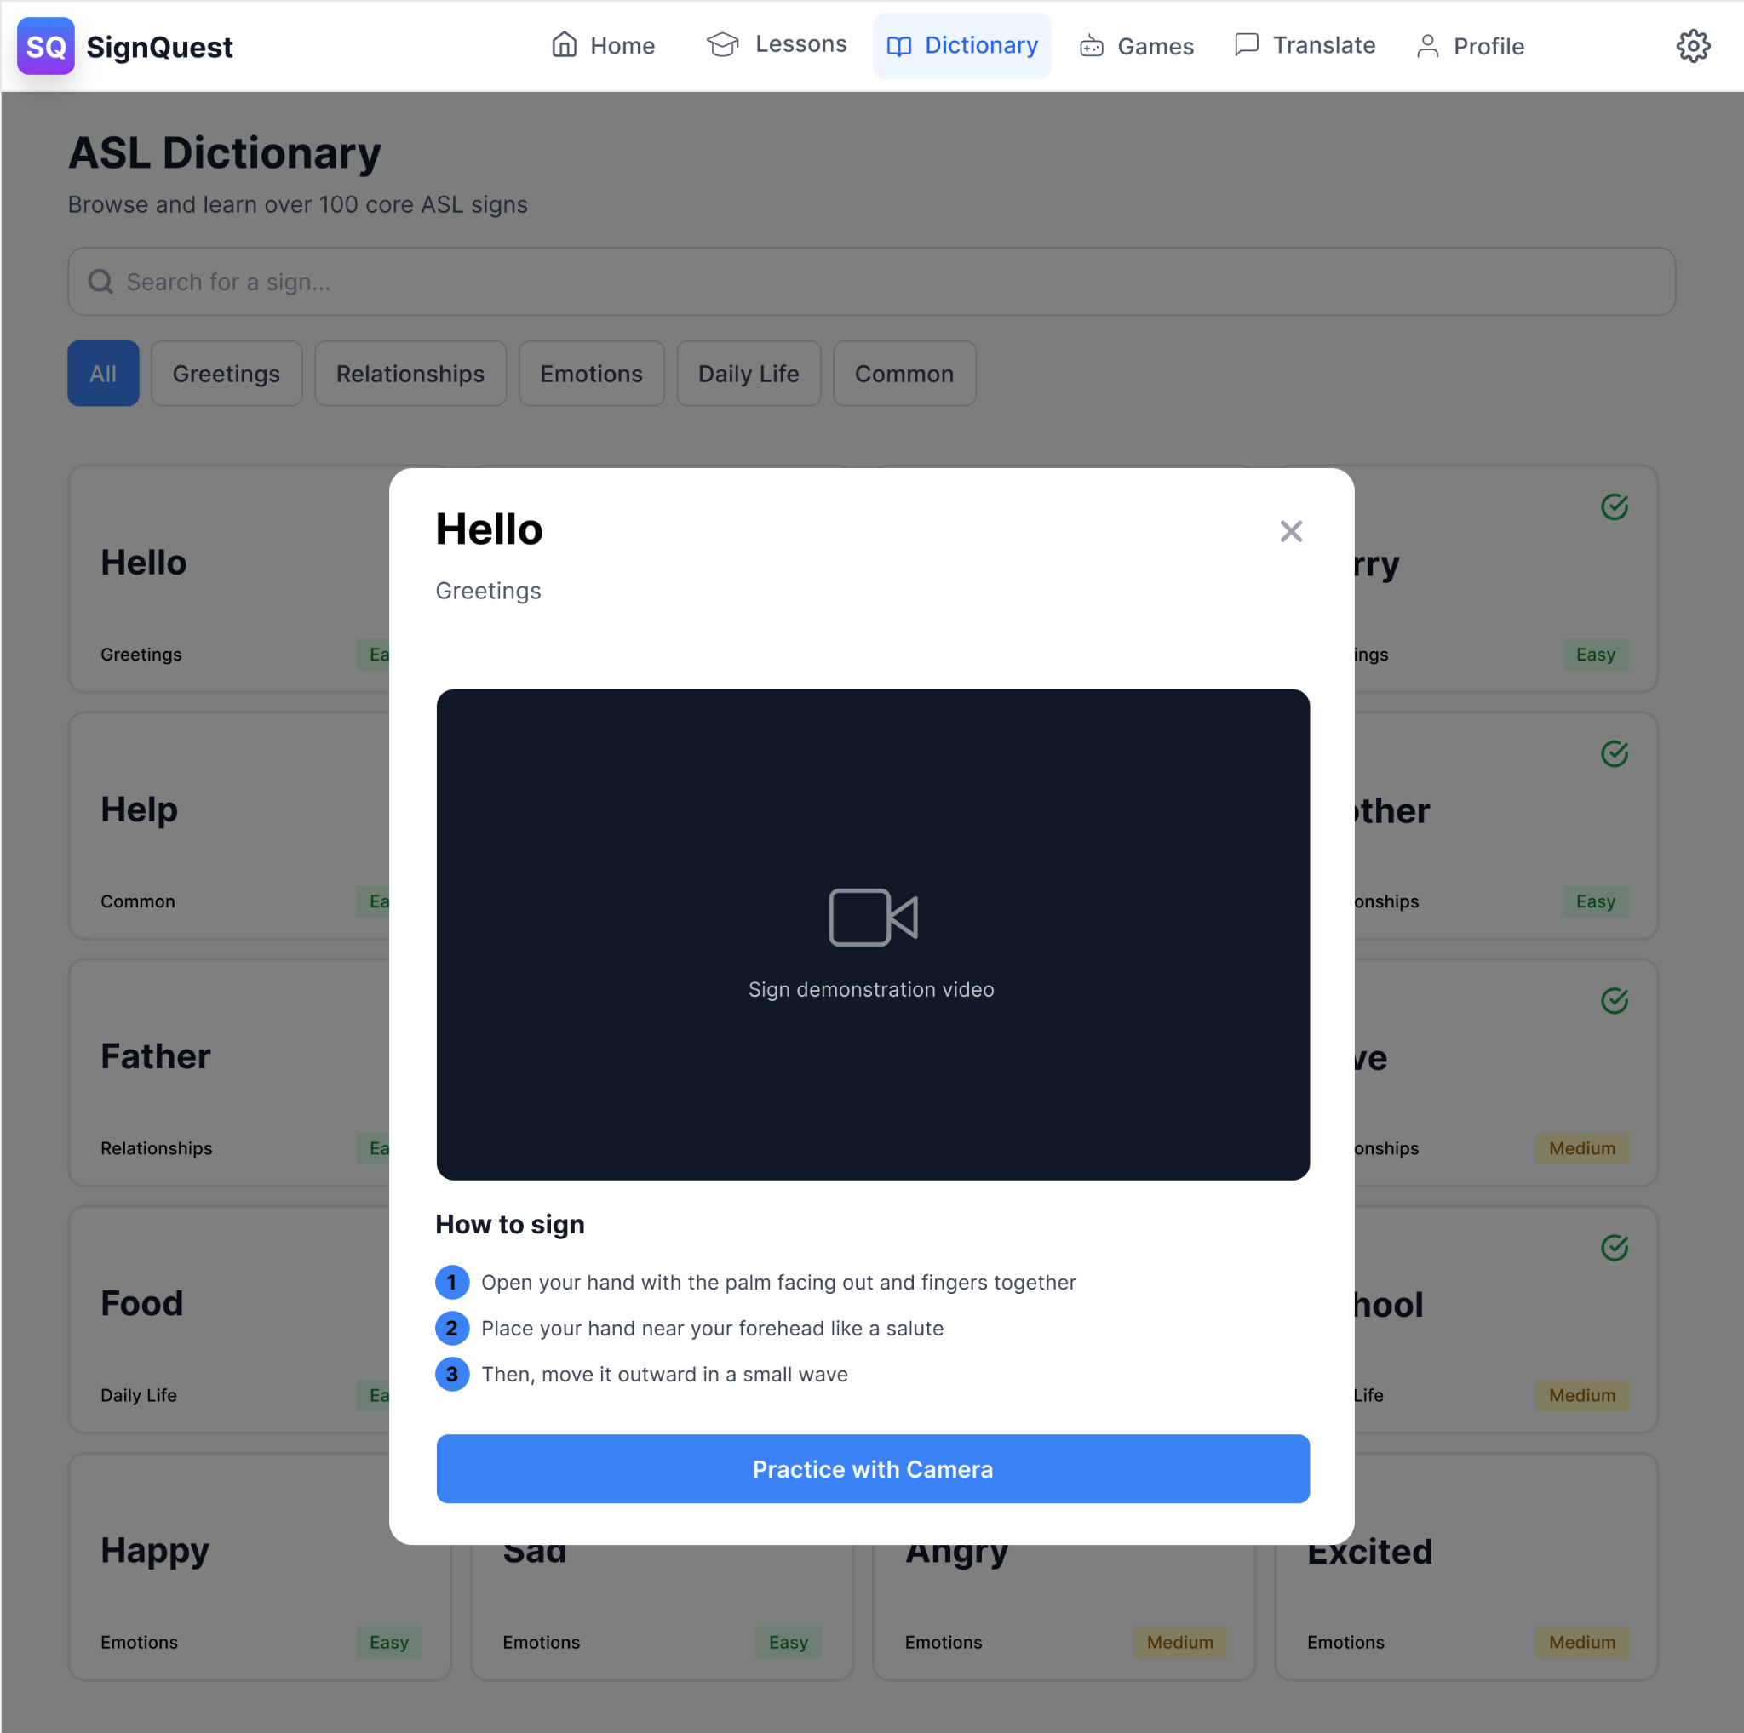
Learning Objects
Dictionary
Lessons
Notes:
SignQuest uses gamification features to help beginners learn American Sign language through many steps such as:
Lessons: Consisting of ……
Dictionary: where users can search by difficulty to find specific words and signs and how they are done
Games:
Translate: Live translation of a person sign language

Slide 11
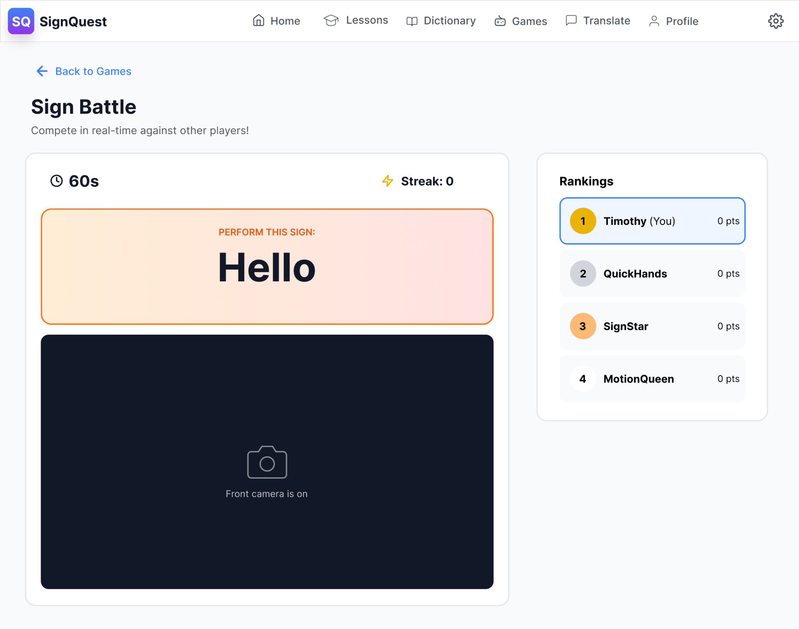
Learning Objects
Games
Sign Battle
Lessons
Dictionary
Notes:
SignQuest uses gamification features to help beginners learn American Sign language through many steps such as:
Lessons: Consisting of ……
Dictionary: where users can search by difficulty to find specific words and signs and how they are done
Games:
Translate: Live translation of a person sign language

Slide 12
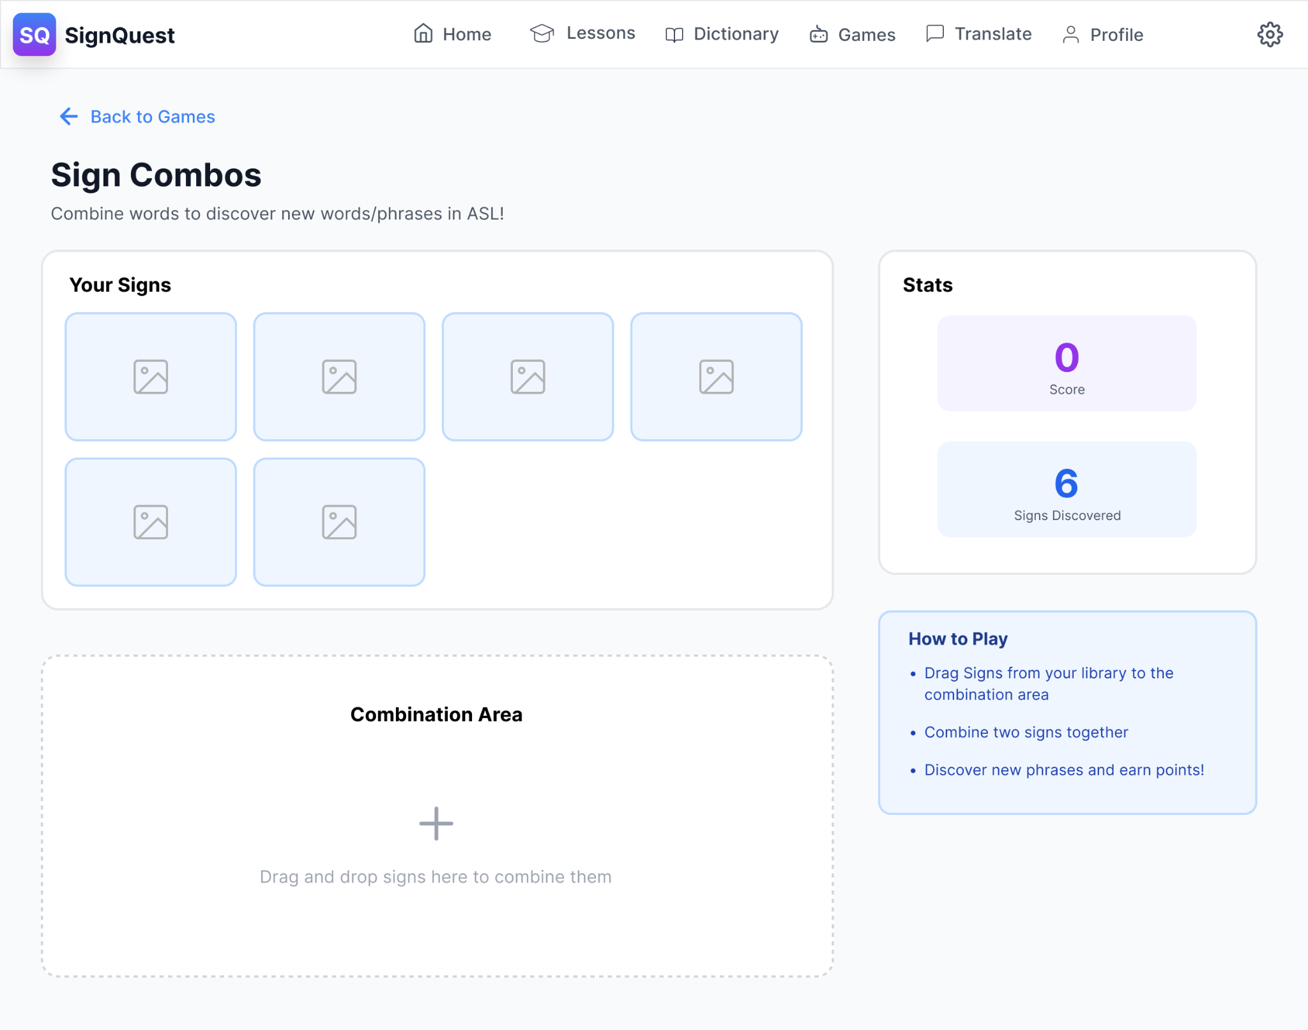
Learning Objects
Games
Sign Combo
Lessons
Dictionary
Notes:
SignQuest uses gamification features to help beginners learn American Sign language through many steps such as:
Lessons: Consisting of ……
Dictionary: where users can search by difficulty to find specific words and signs and how they are done
Games:
Translate: Live translation of a person sign language

Slide 13
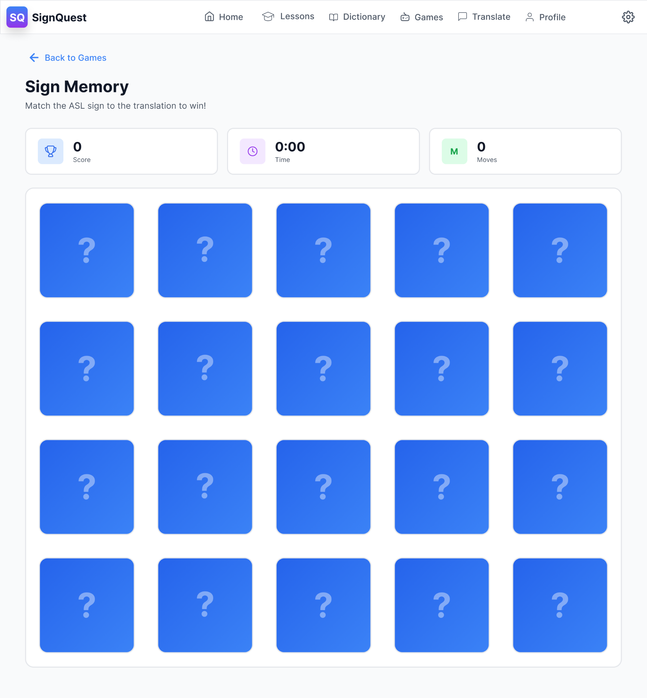
Learning Objects
Games
Sign Memory
Lessons
Dictionary
Notes:
SignQuest uses gamification features to help beginners learn American Sign language through many steps such as:
Lessons: Consisting of ……
Dictionary: where users can search by difficulty to find specific words and signs and how they are done
Games:
Translate: Live translation of a person sign language

Slide 14
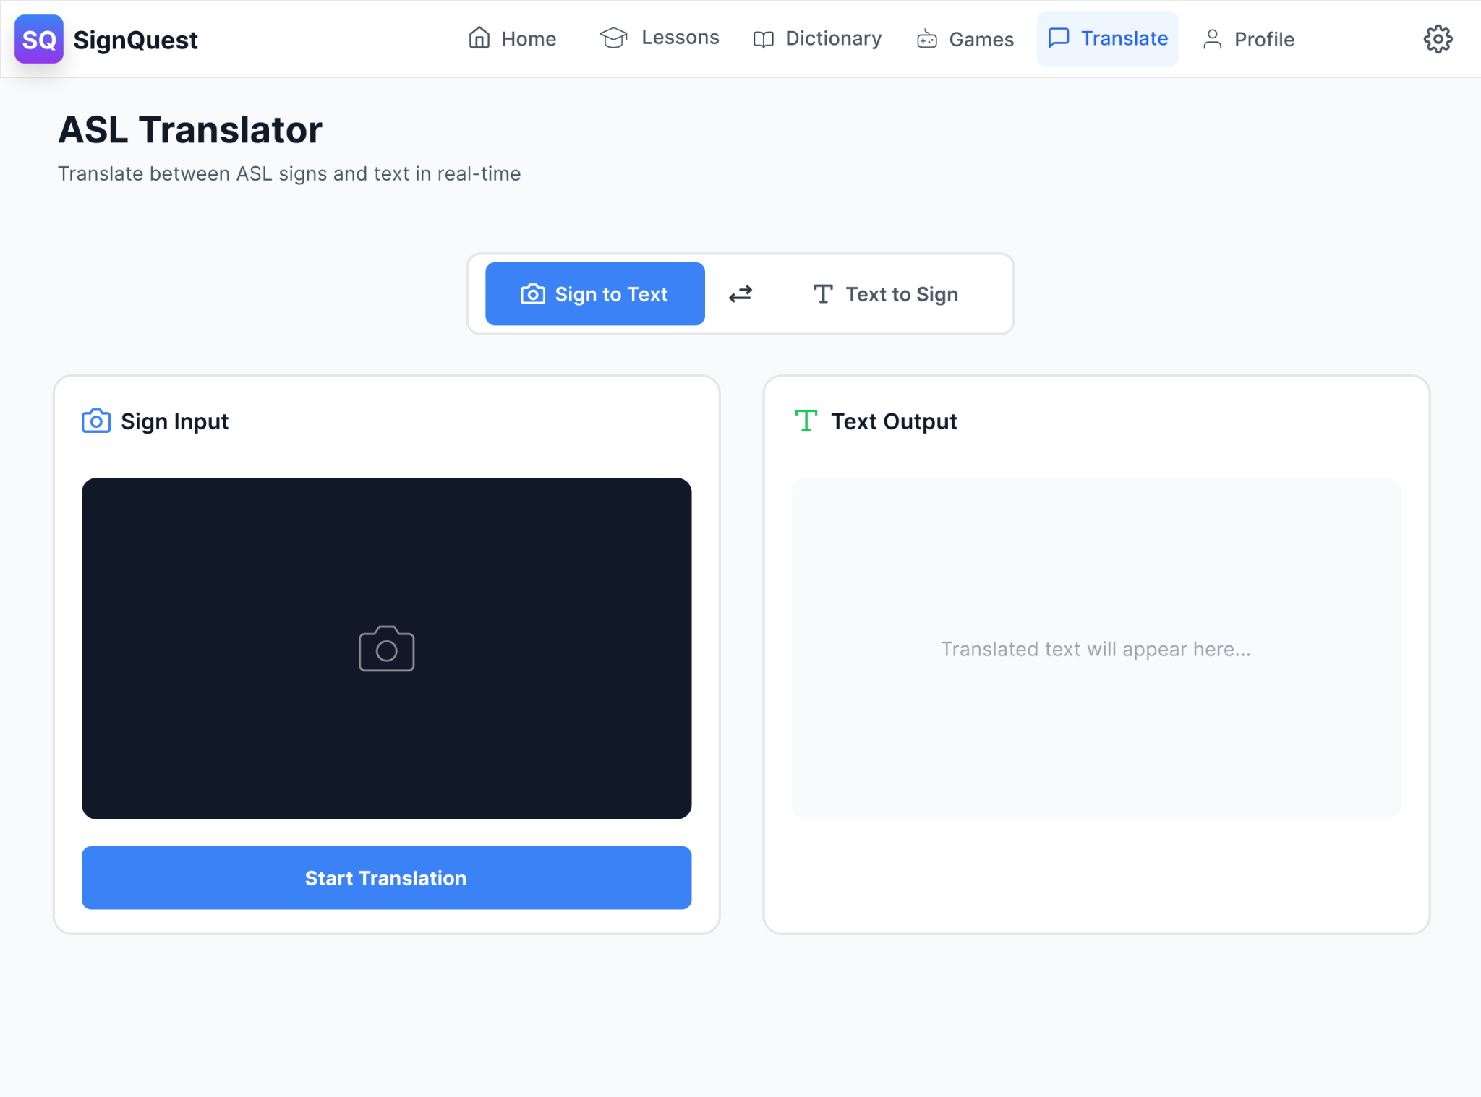
Learning Objects
Translate
Lessons
Dictionary
Games
Notes:
SignQuest uses gamification features to help beginners learn American Sign language through many steps such as:
Lessons: Consisting of ……
Dictionary: where users can search by difficulty to find specific words and signs and how they are done
Games:
Translate: Live translation of a person sign language

Slide 15
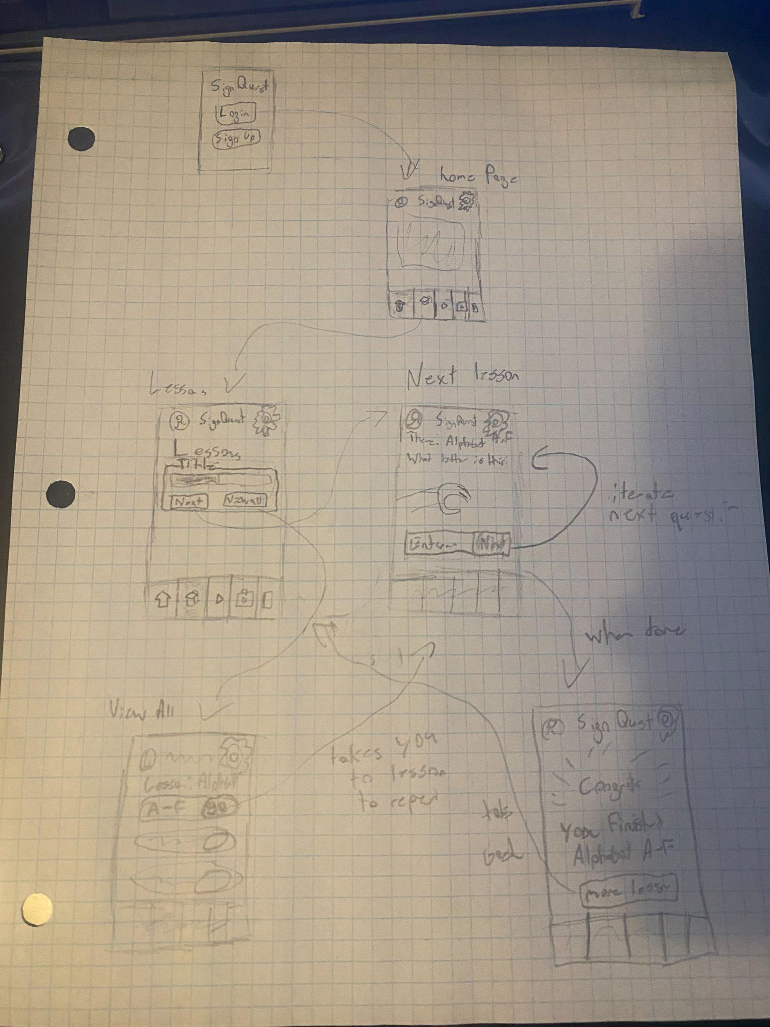
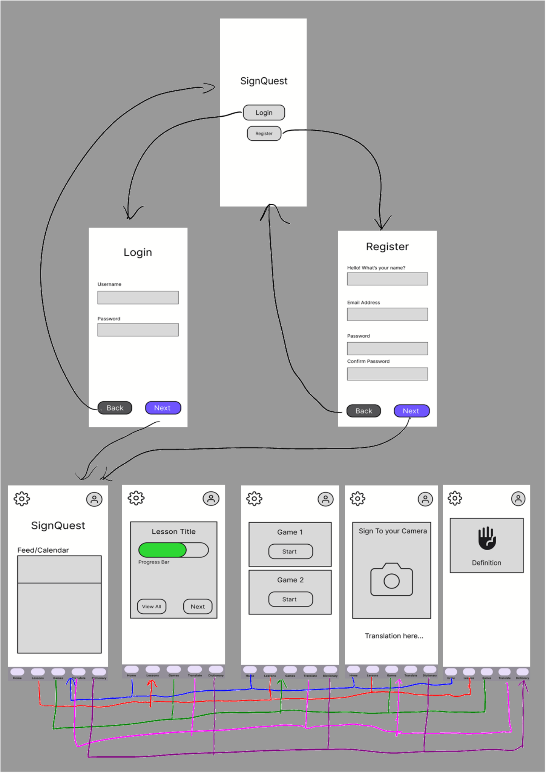
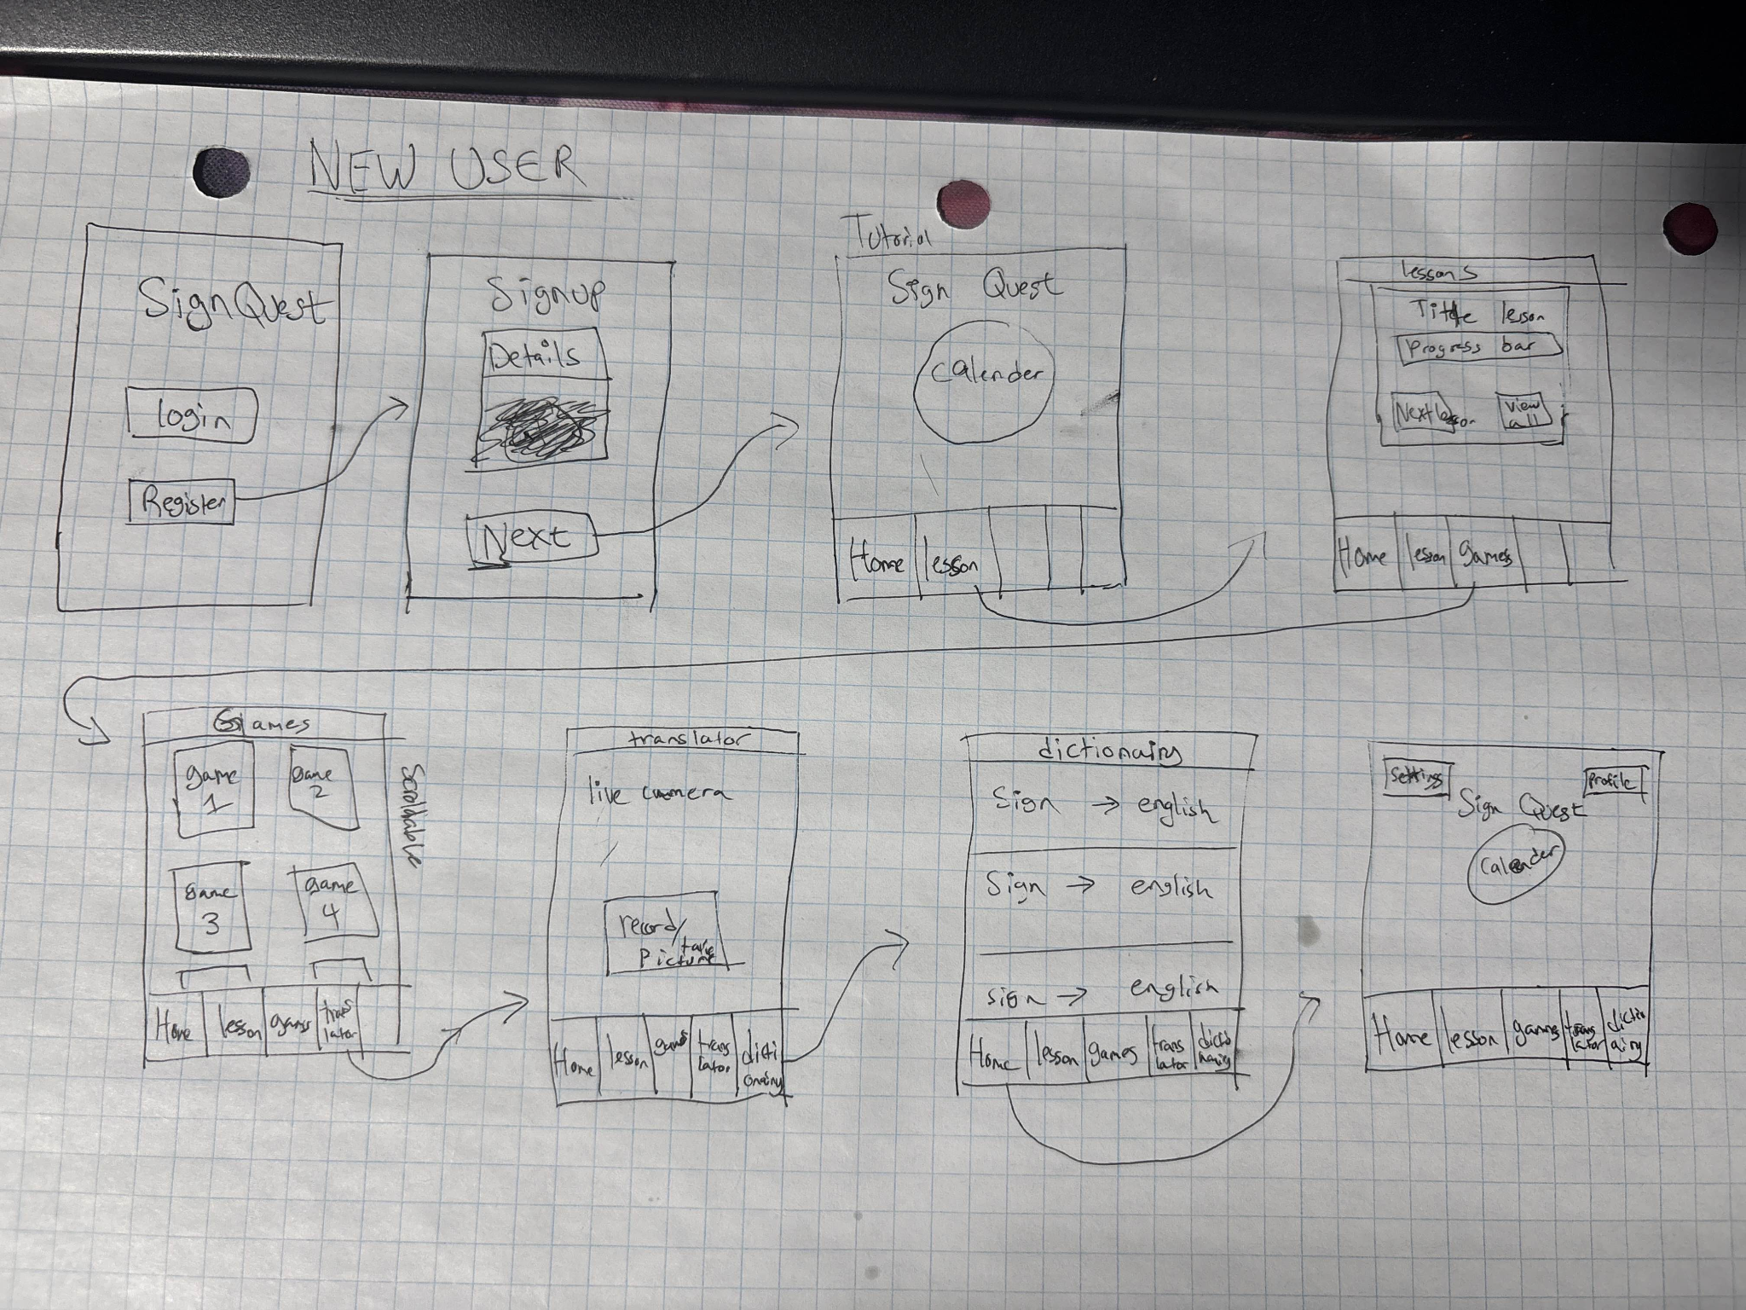
Storyboards V.1
New Users - Lesson
Experienced Users - Games
Main Pages

Slide 16
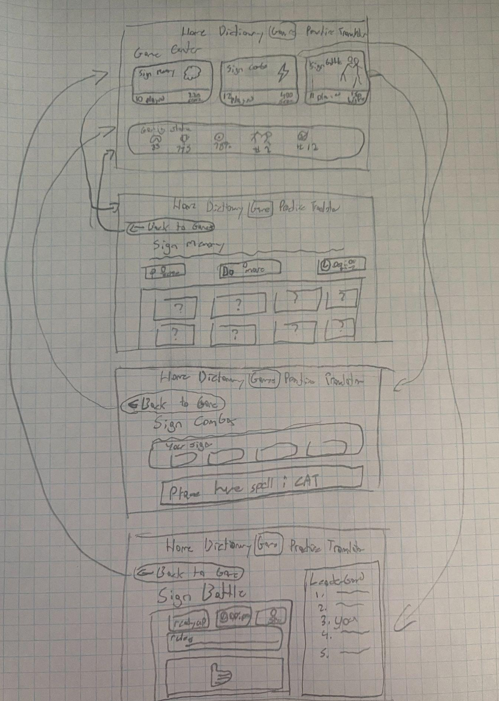
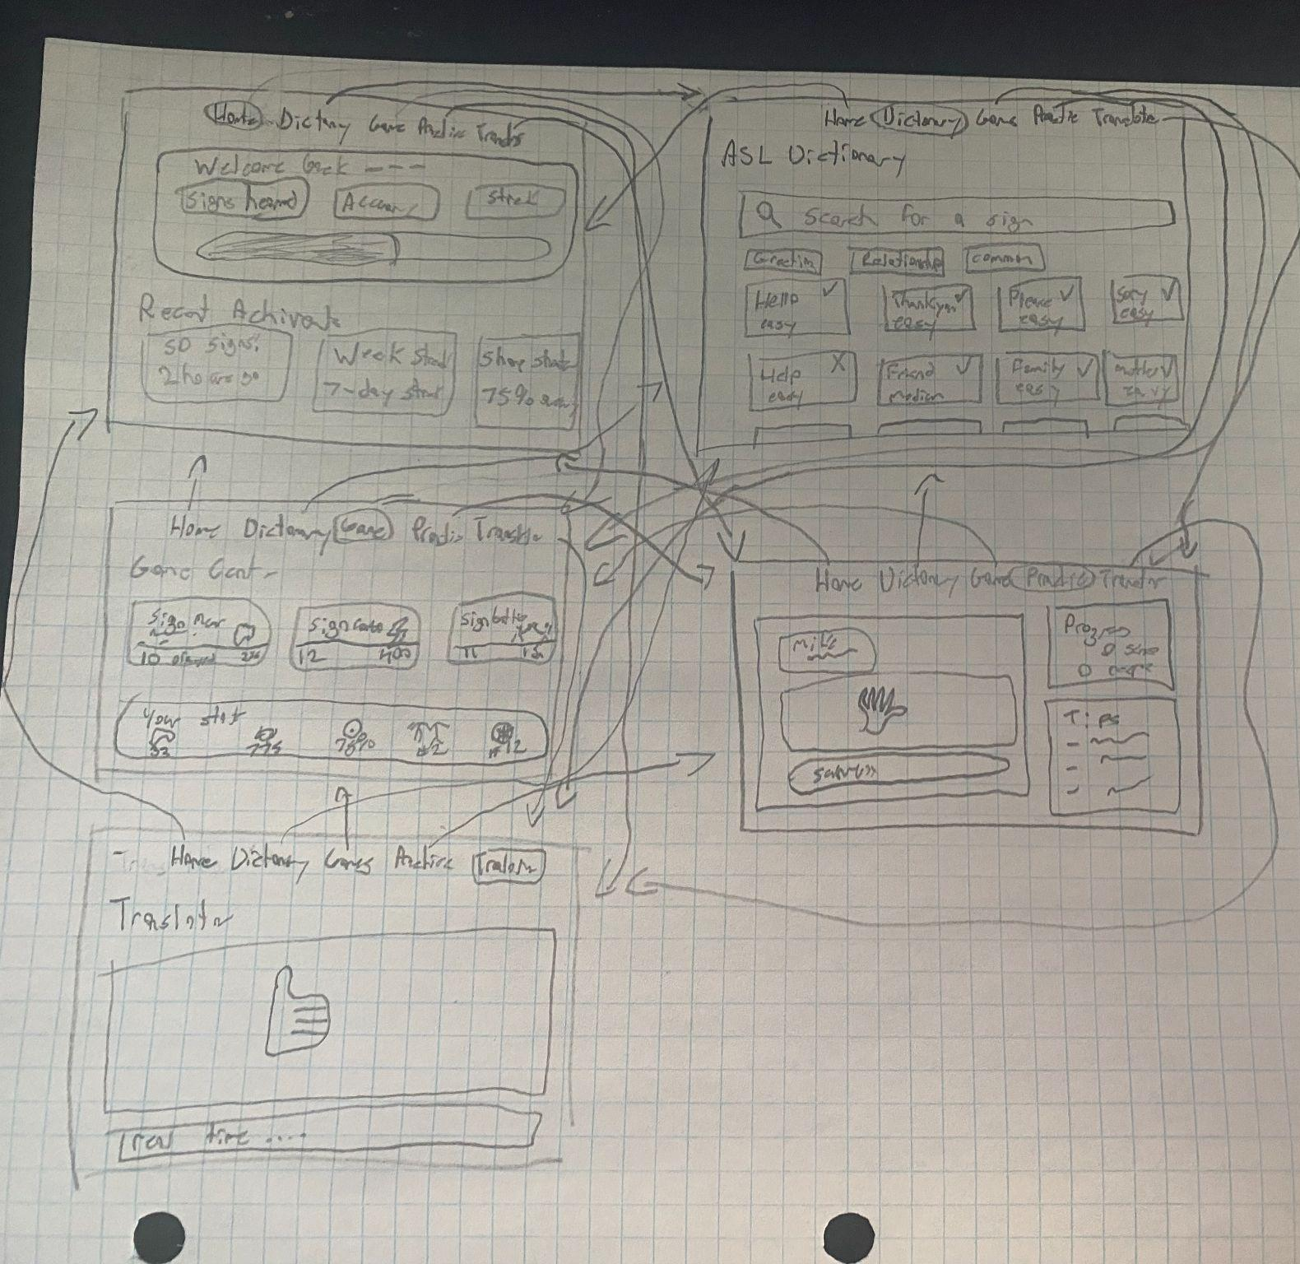
Storyboards V.2
All Games
Nav Bar Screens

Slide 17
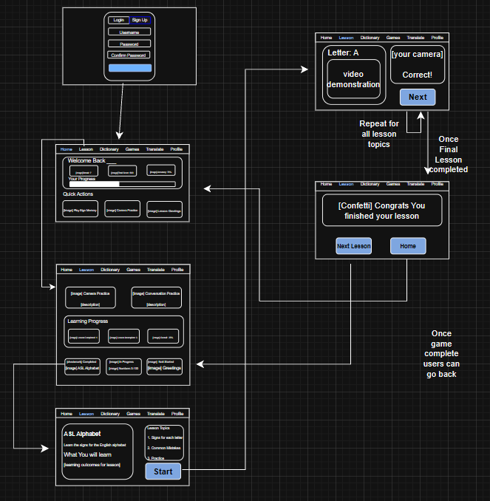
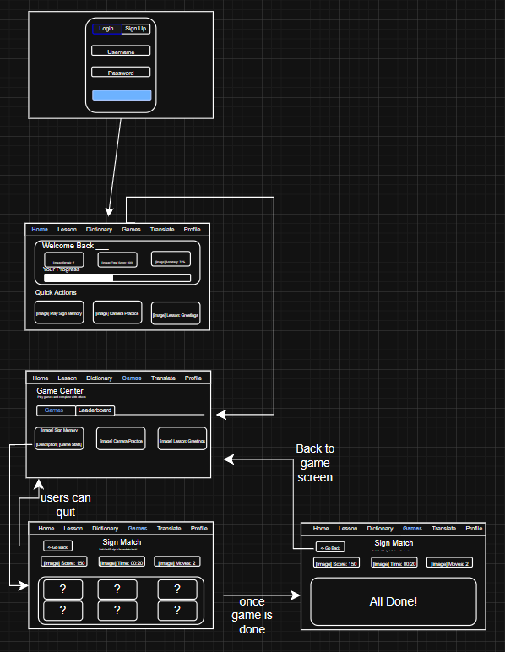
Storyboards V.2
Experienced Users - Games
New Users - Lesson

Slide 18
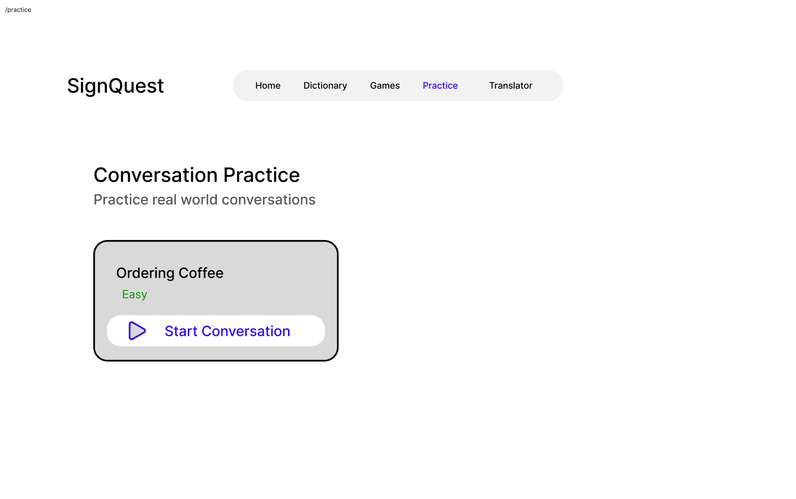
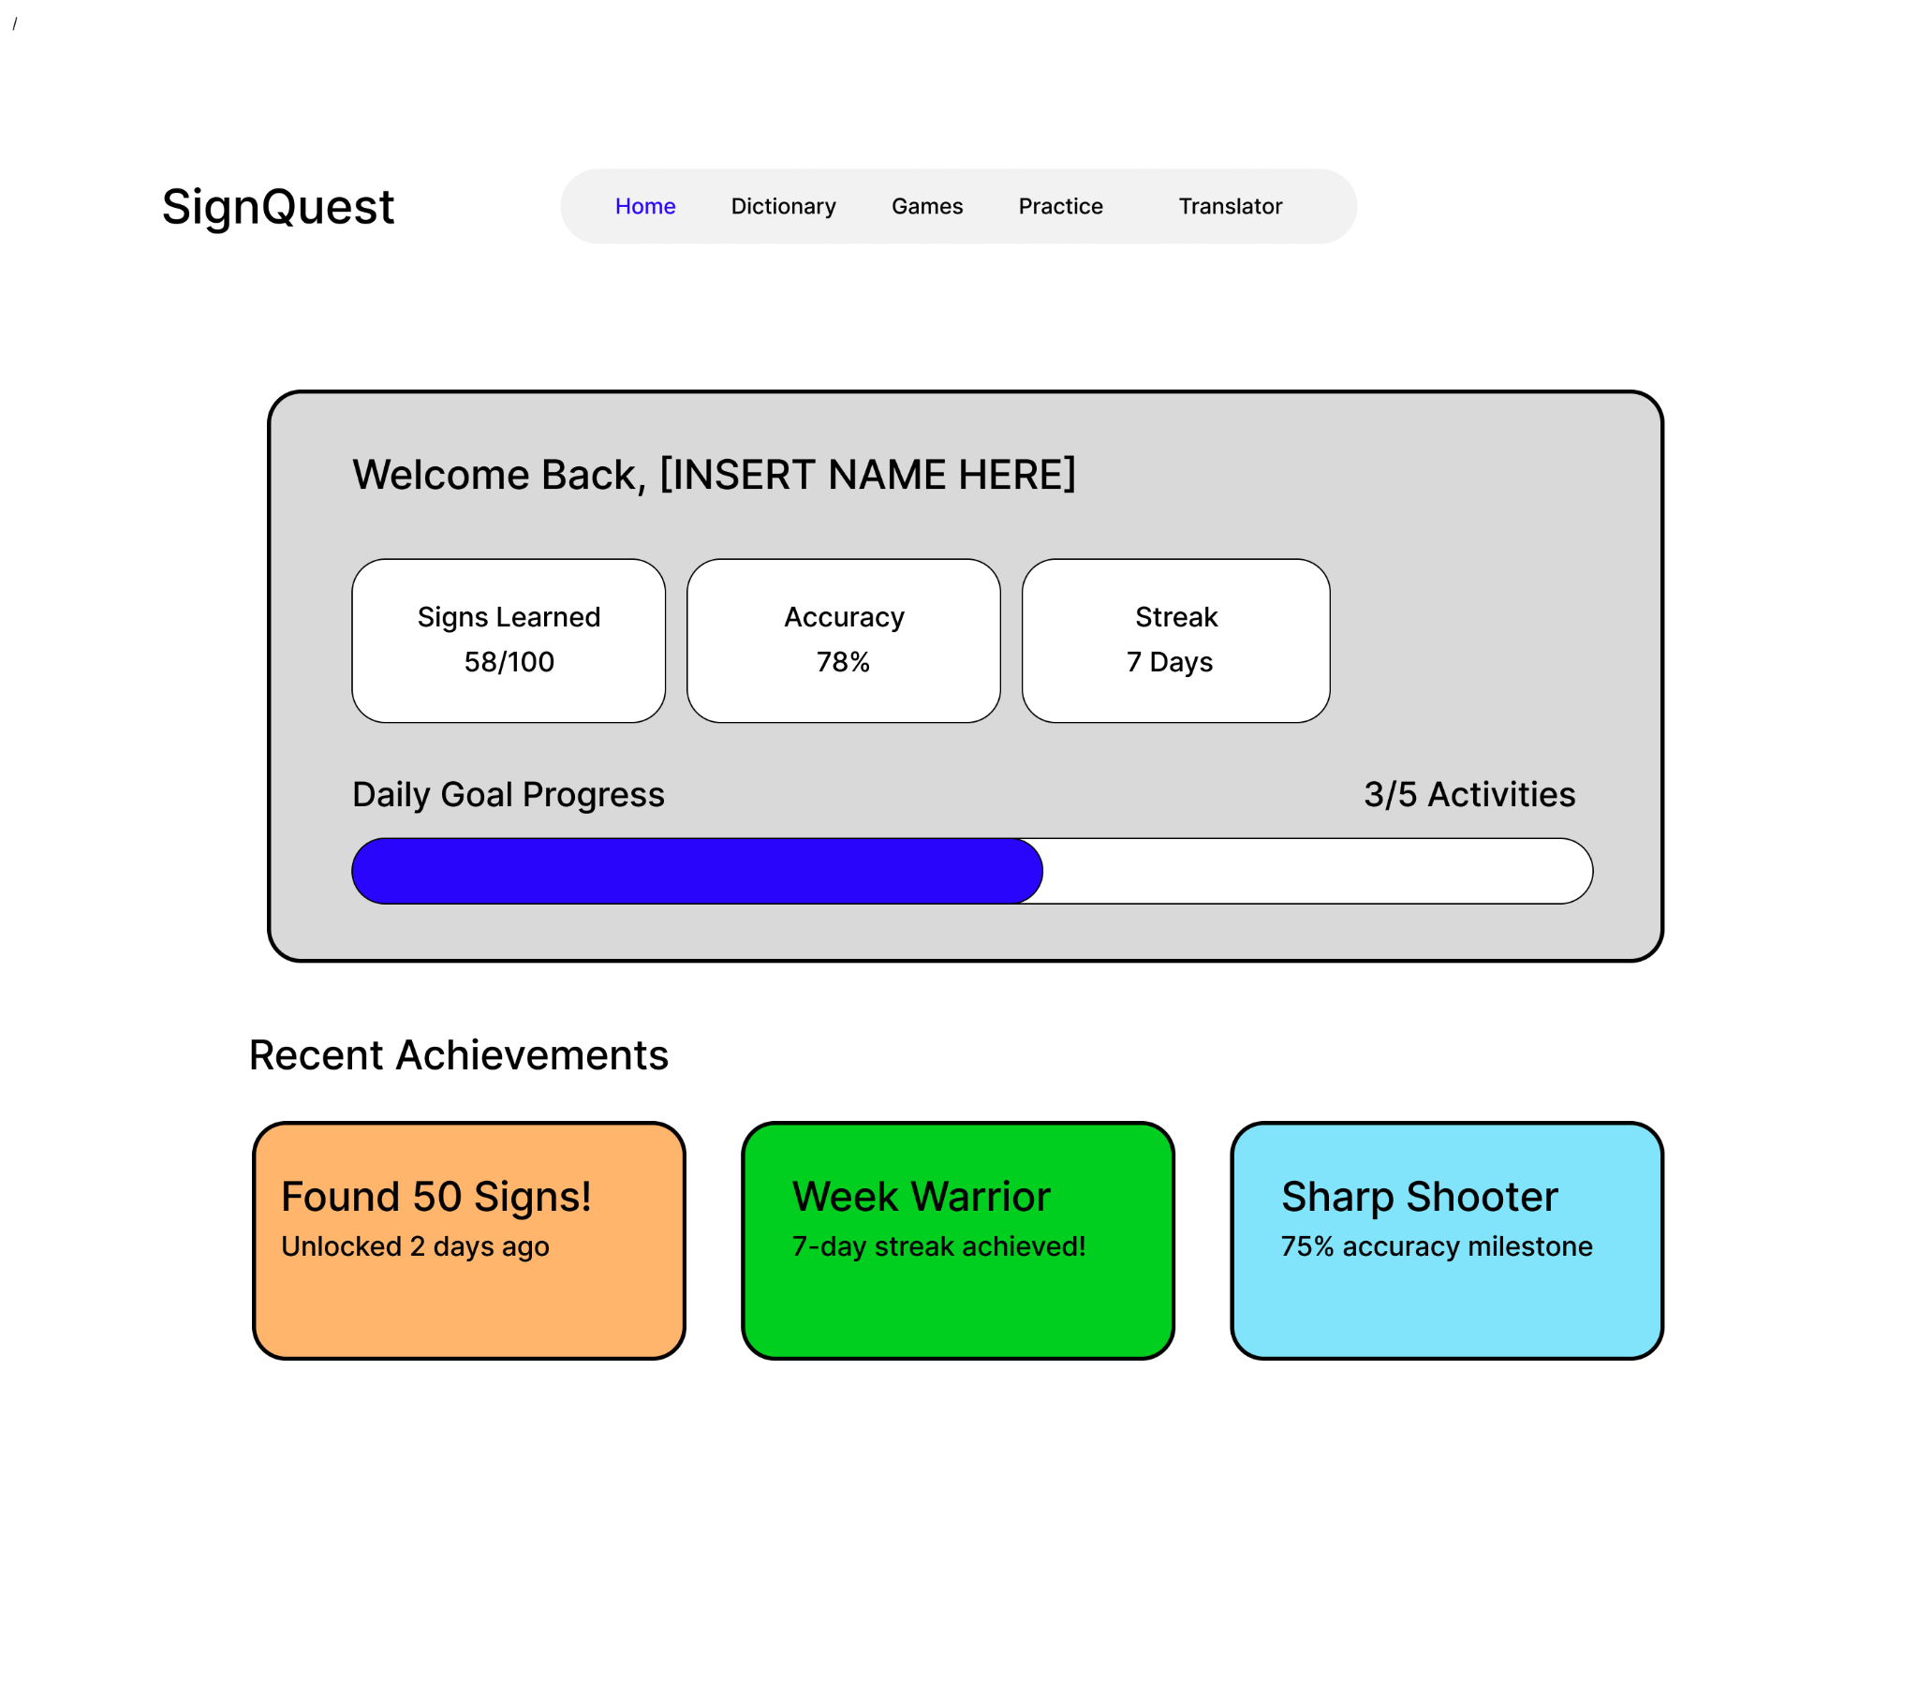
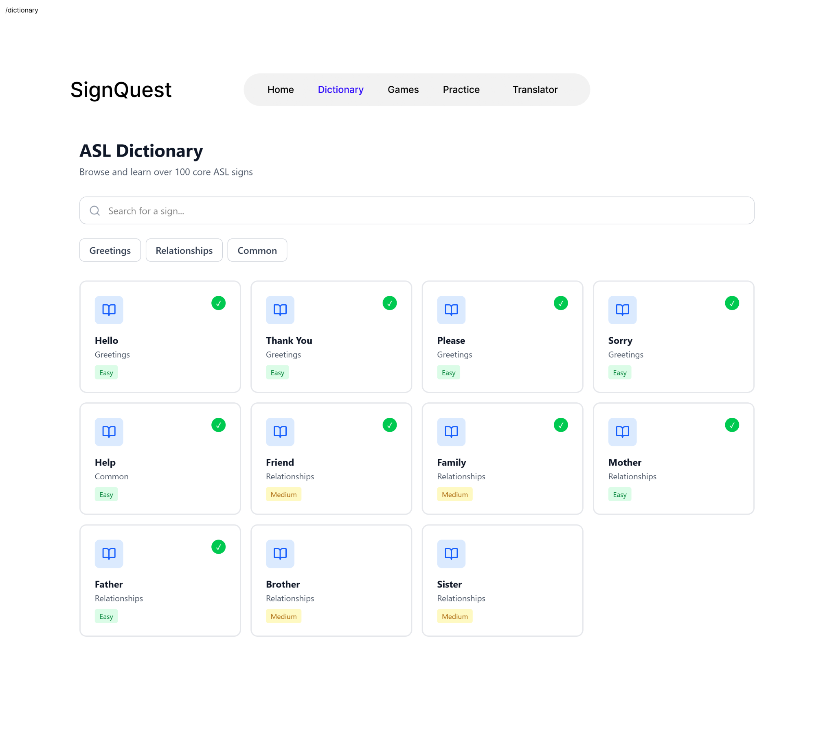
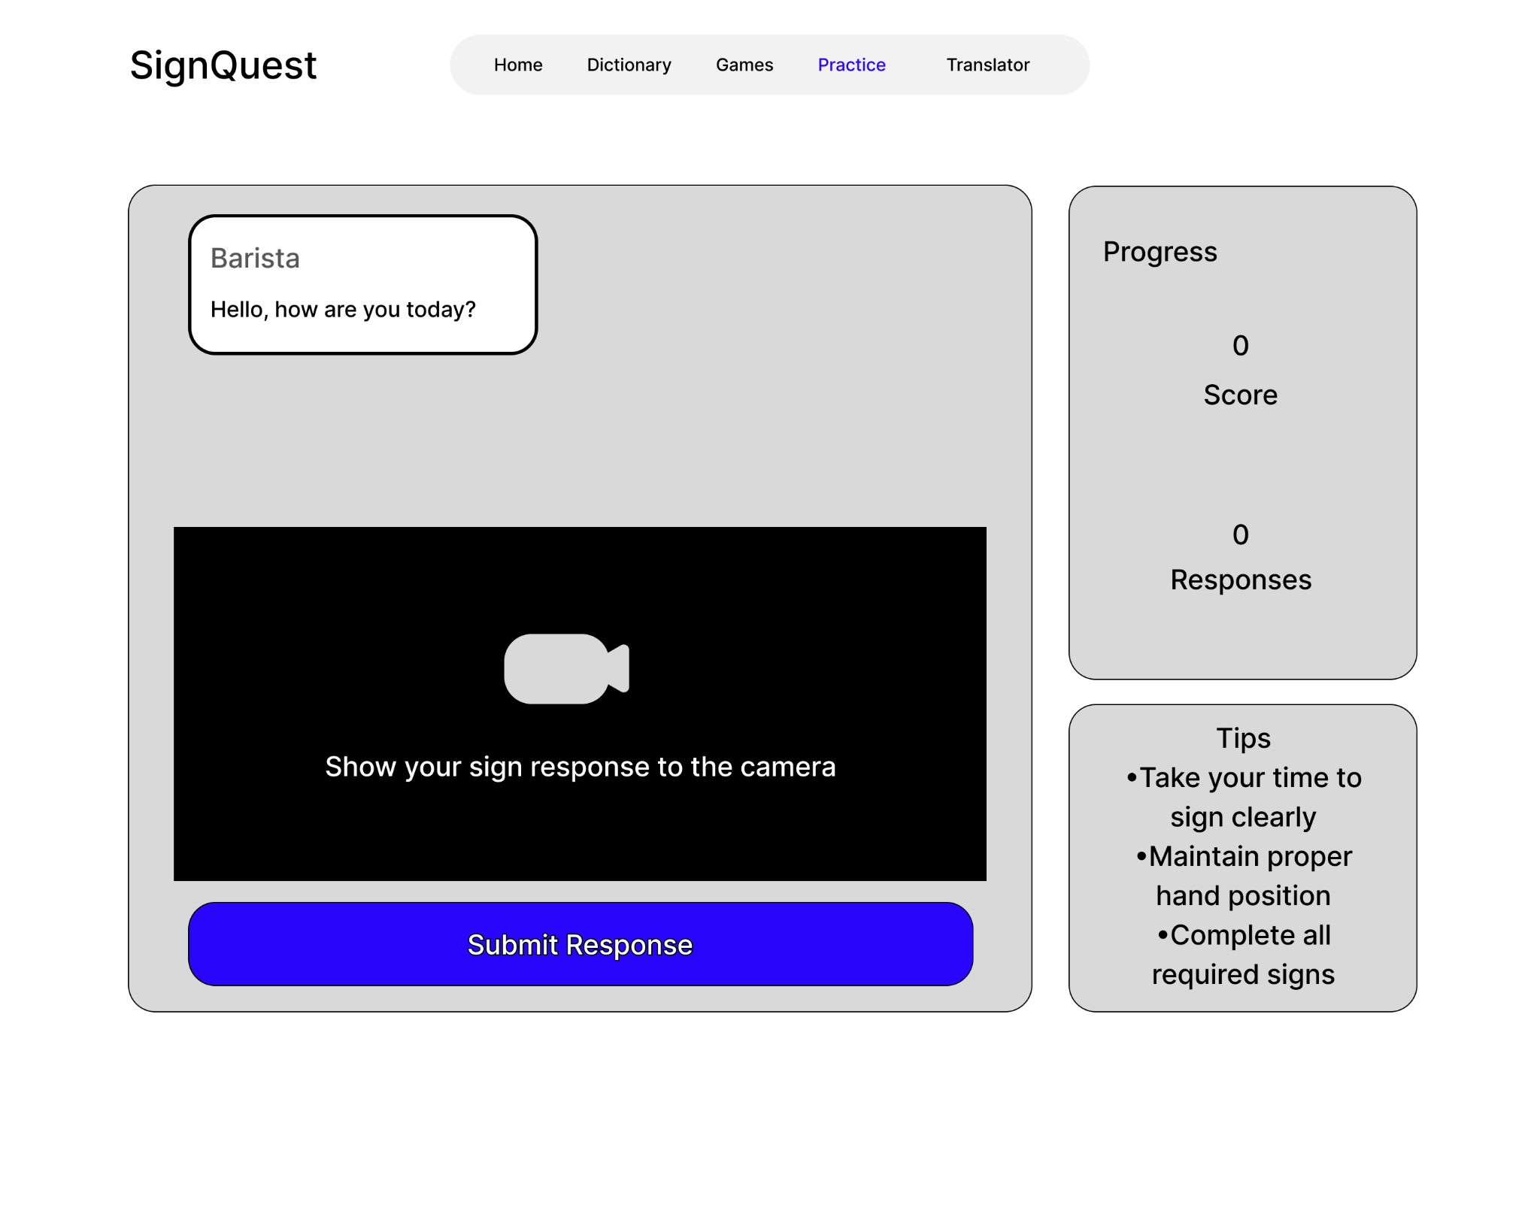
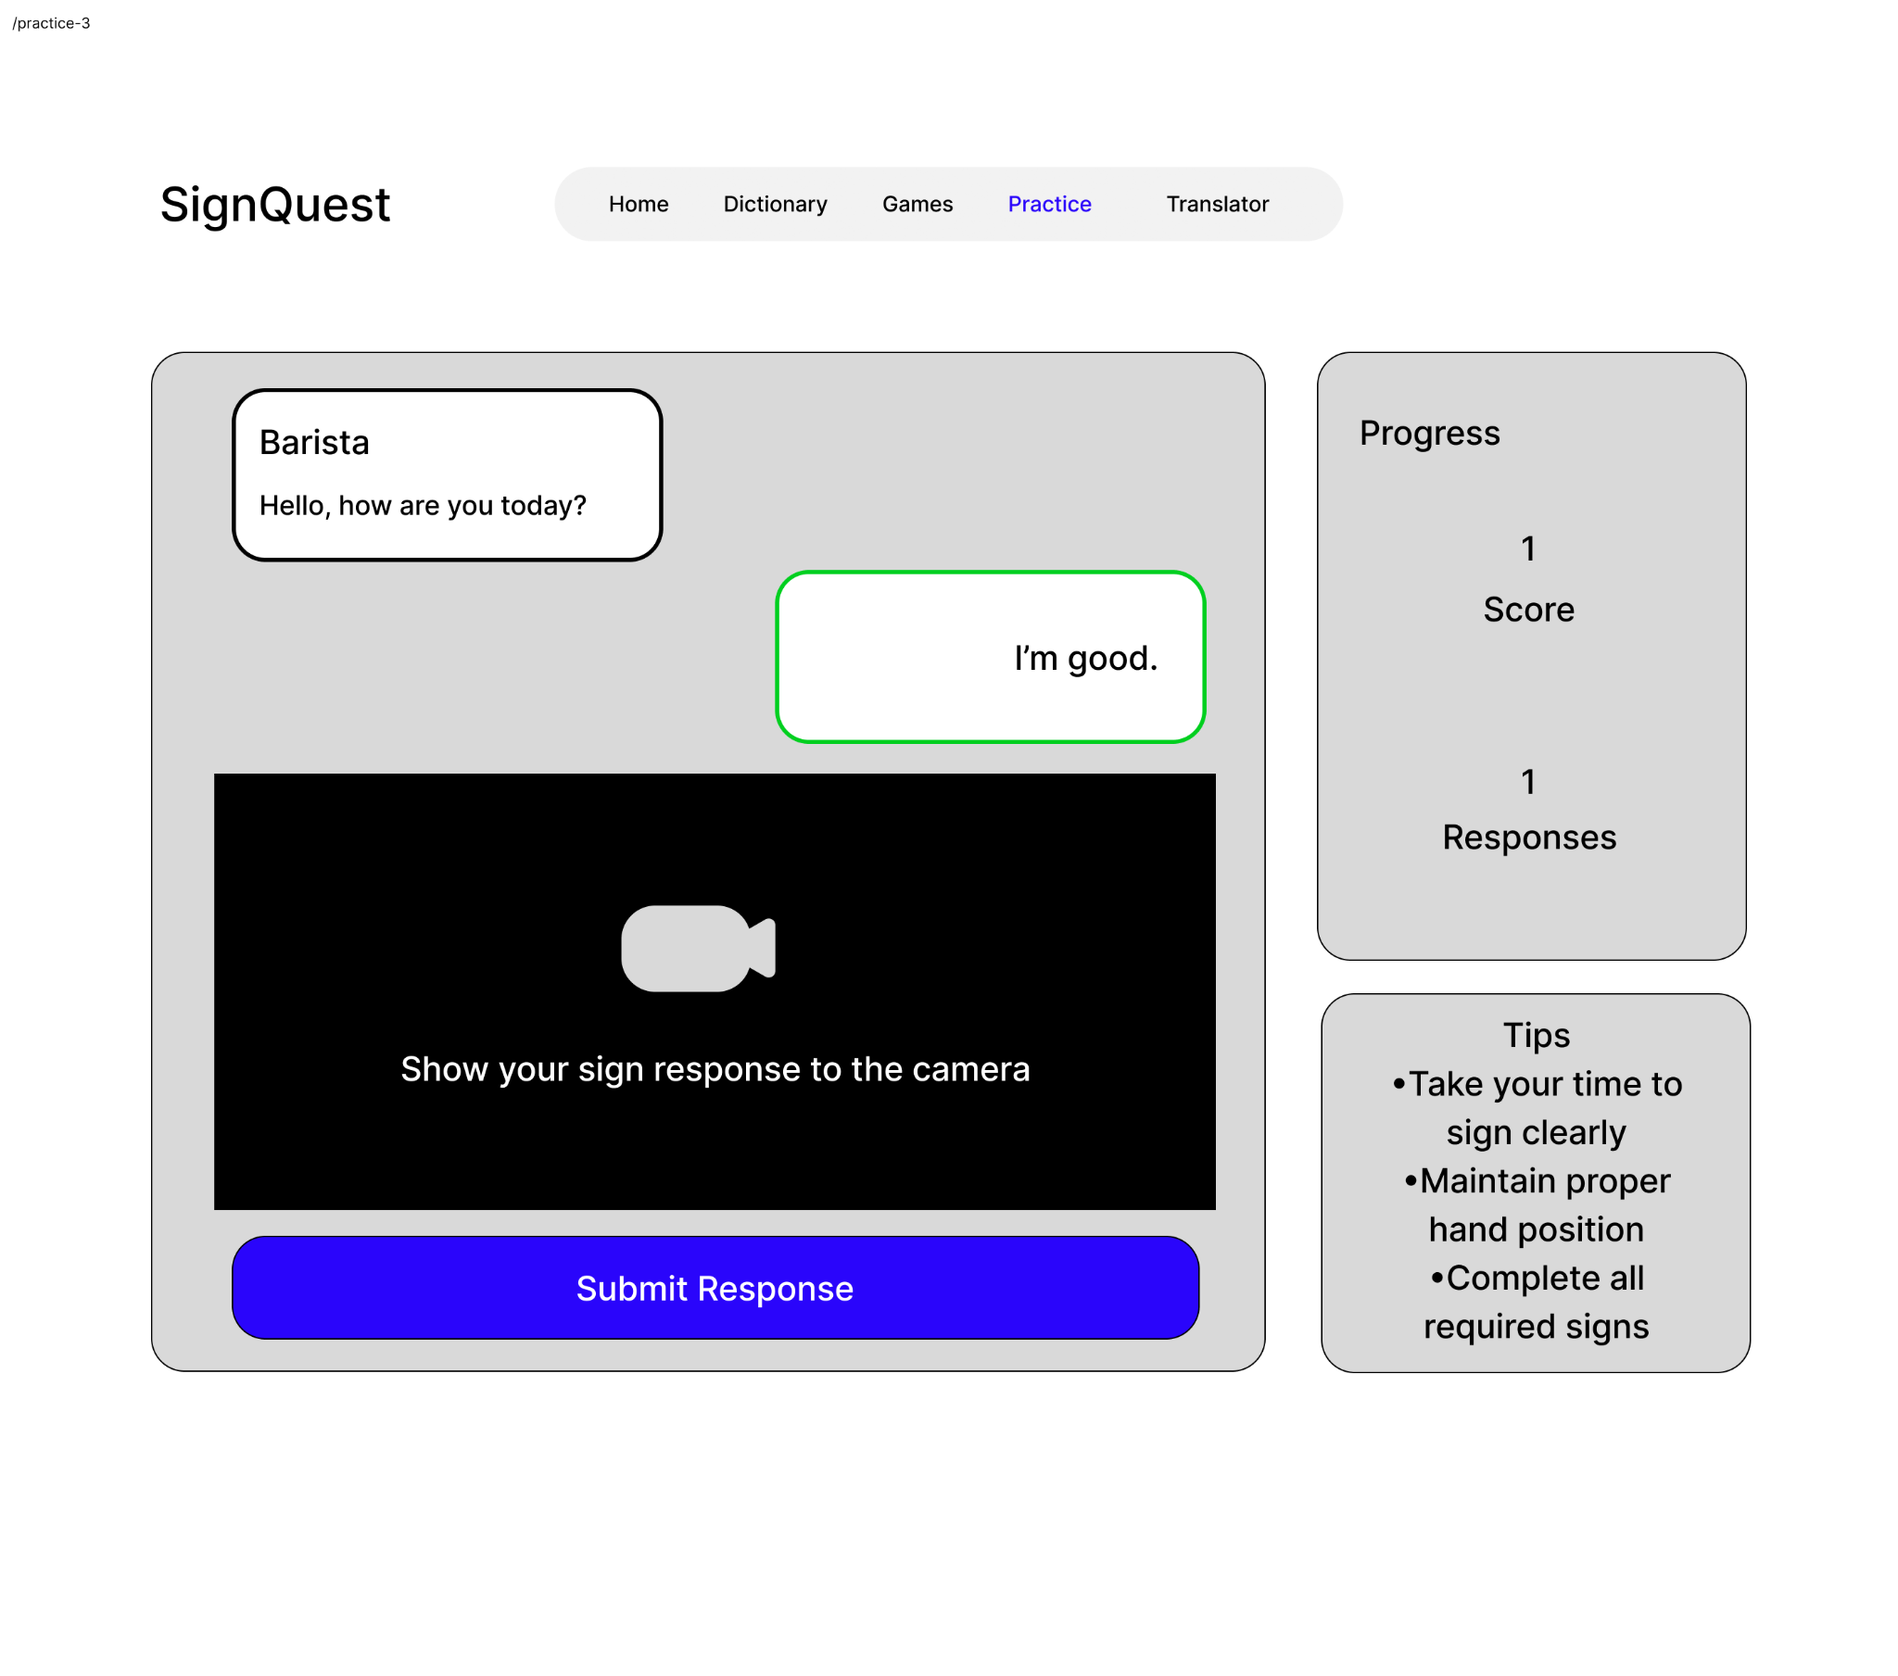
UI Design V.1

Slide 19
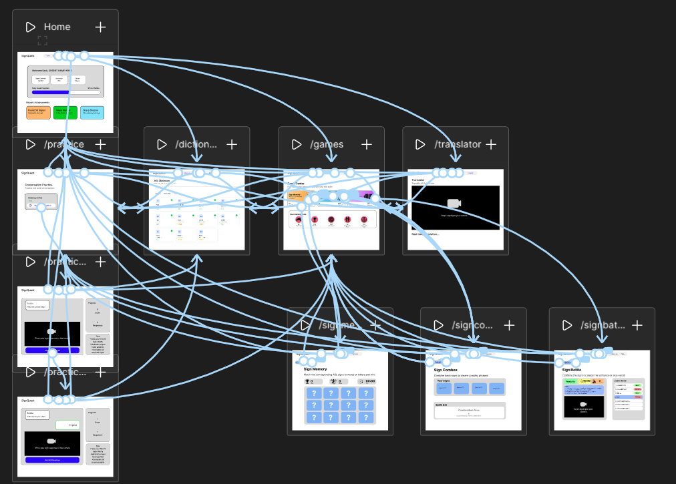
UI Design V1

Slide 20
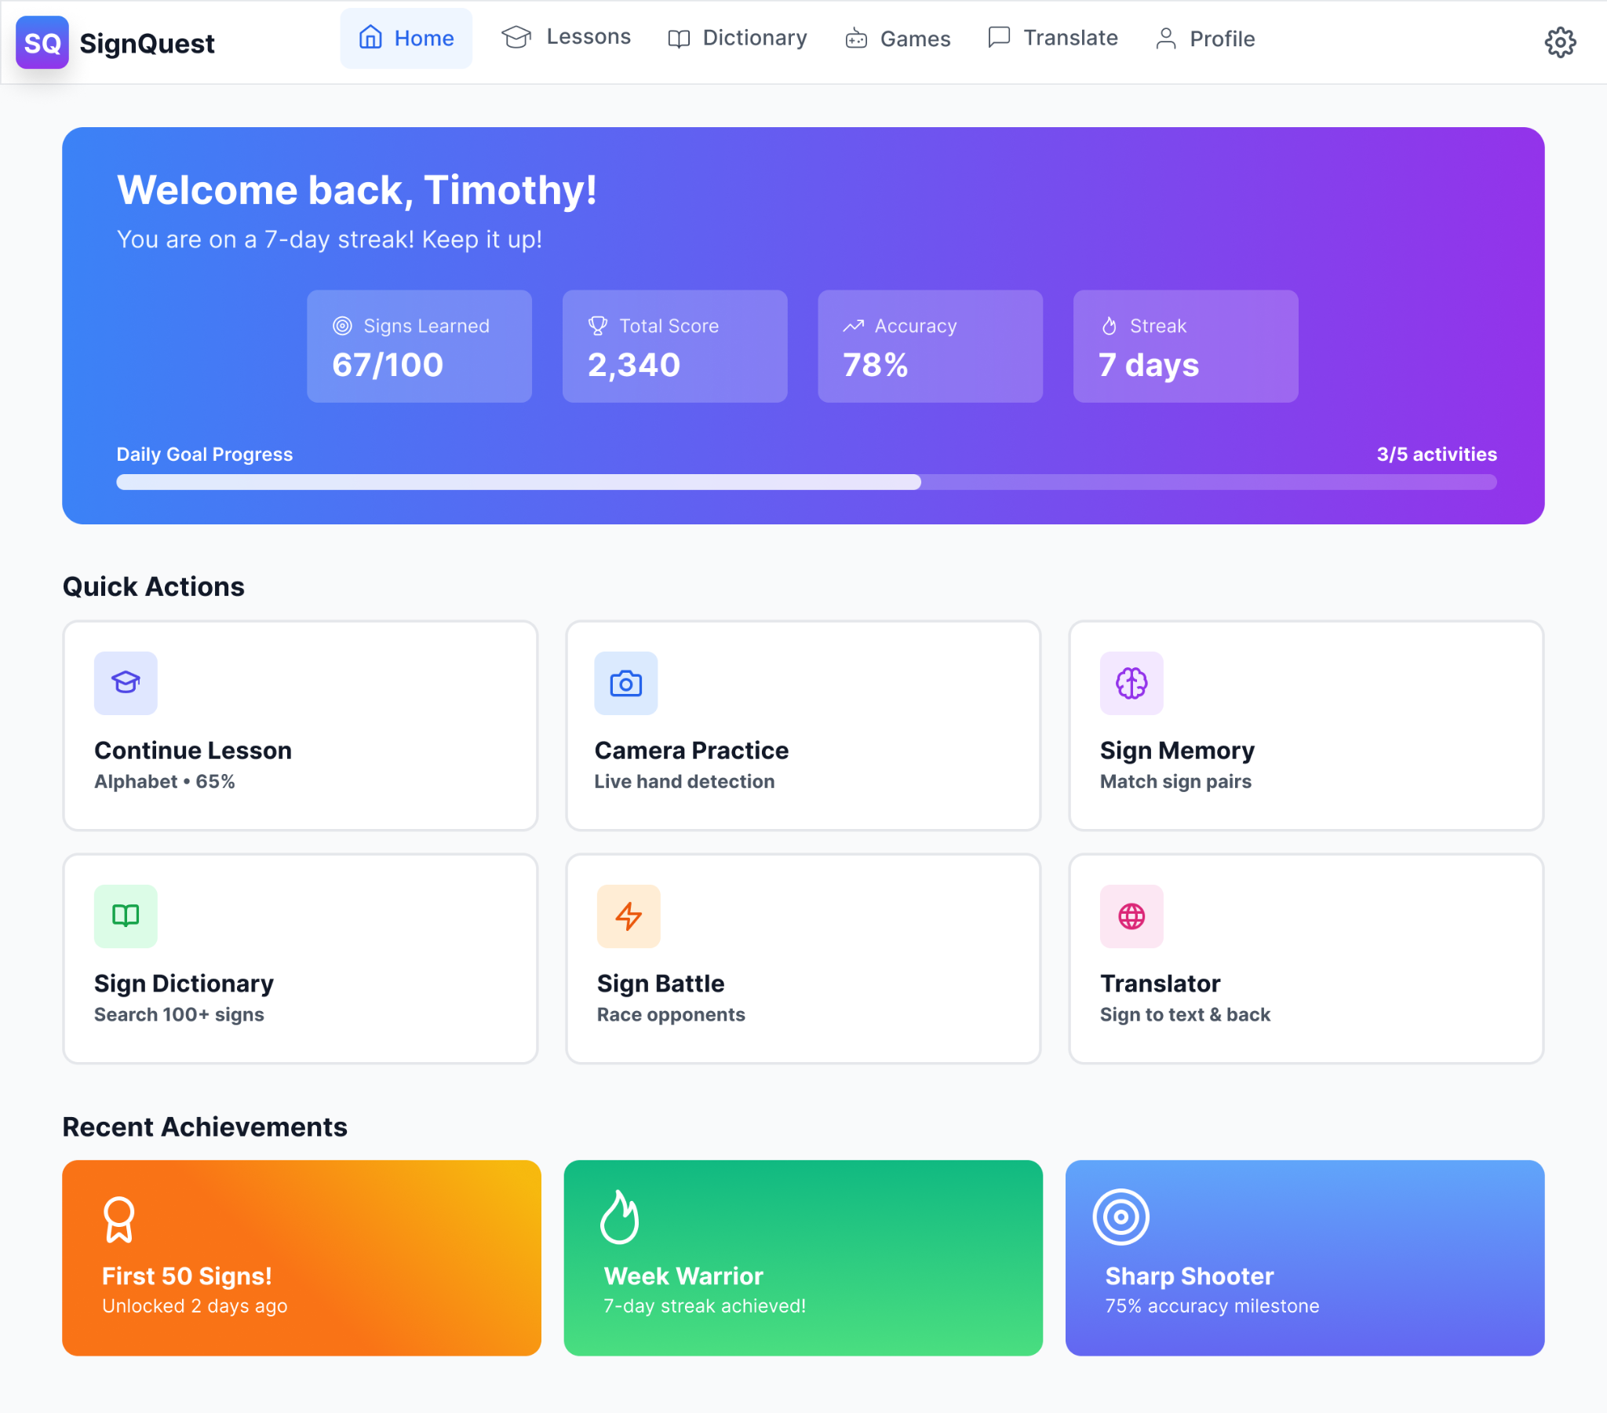
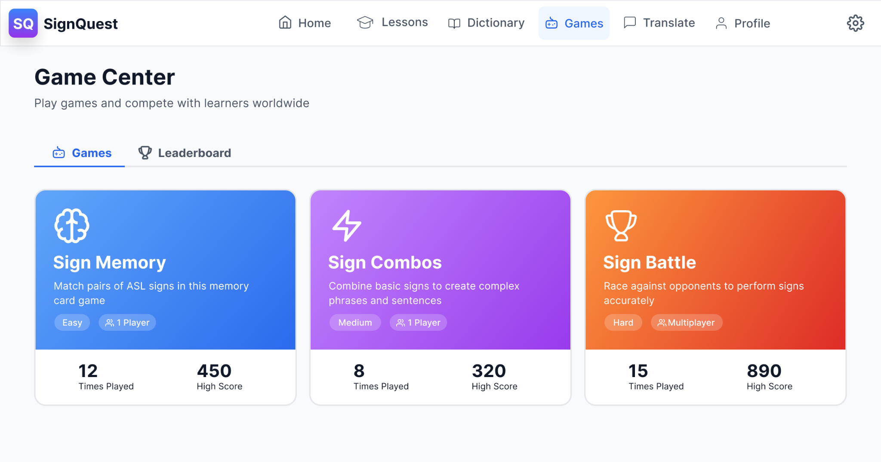
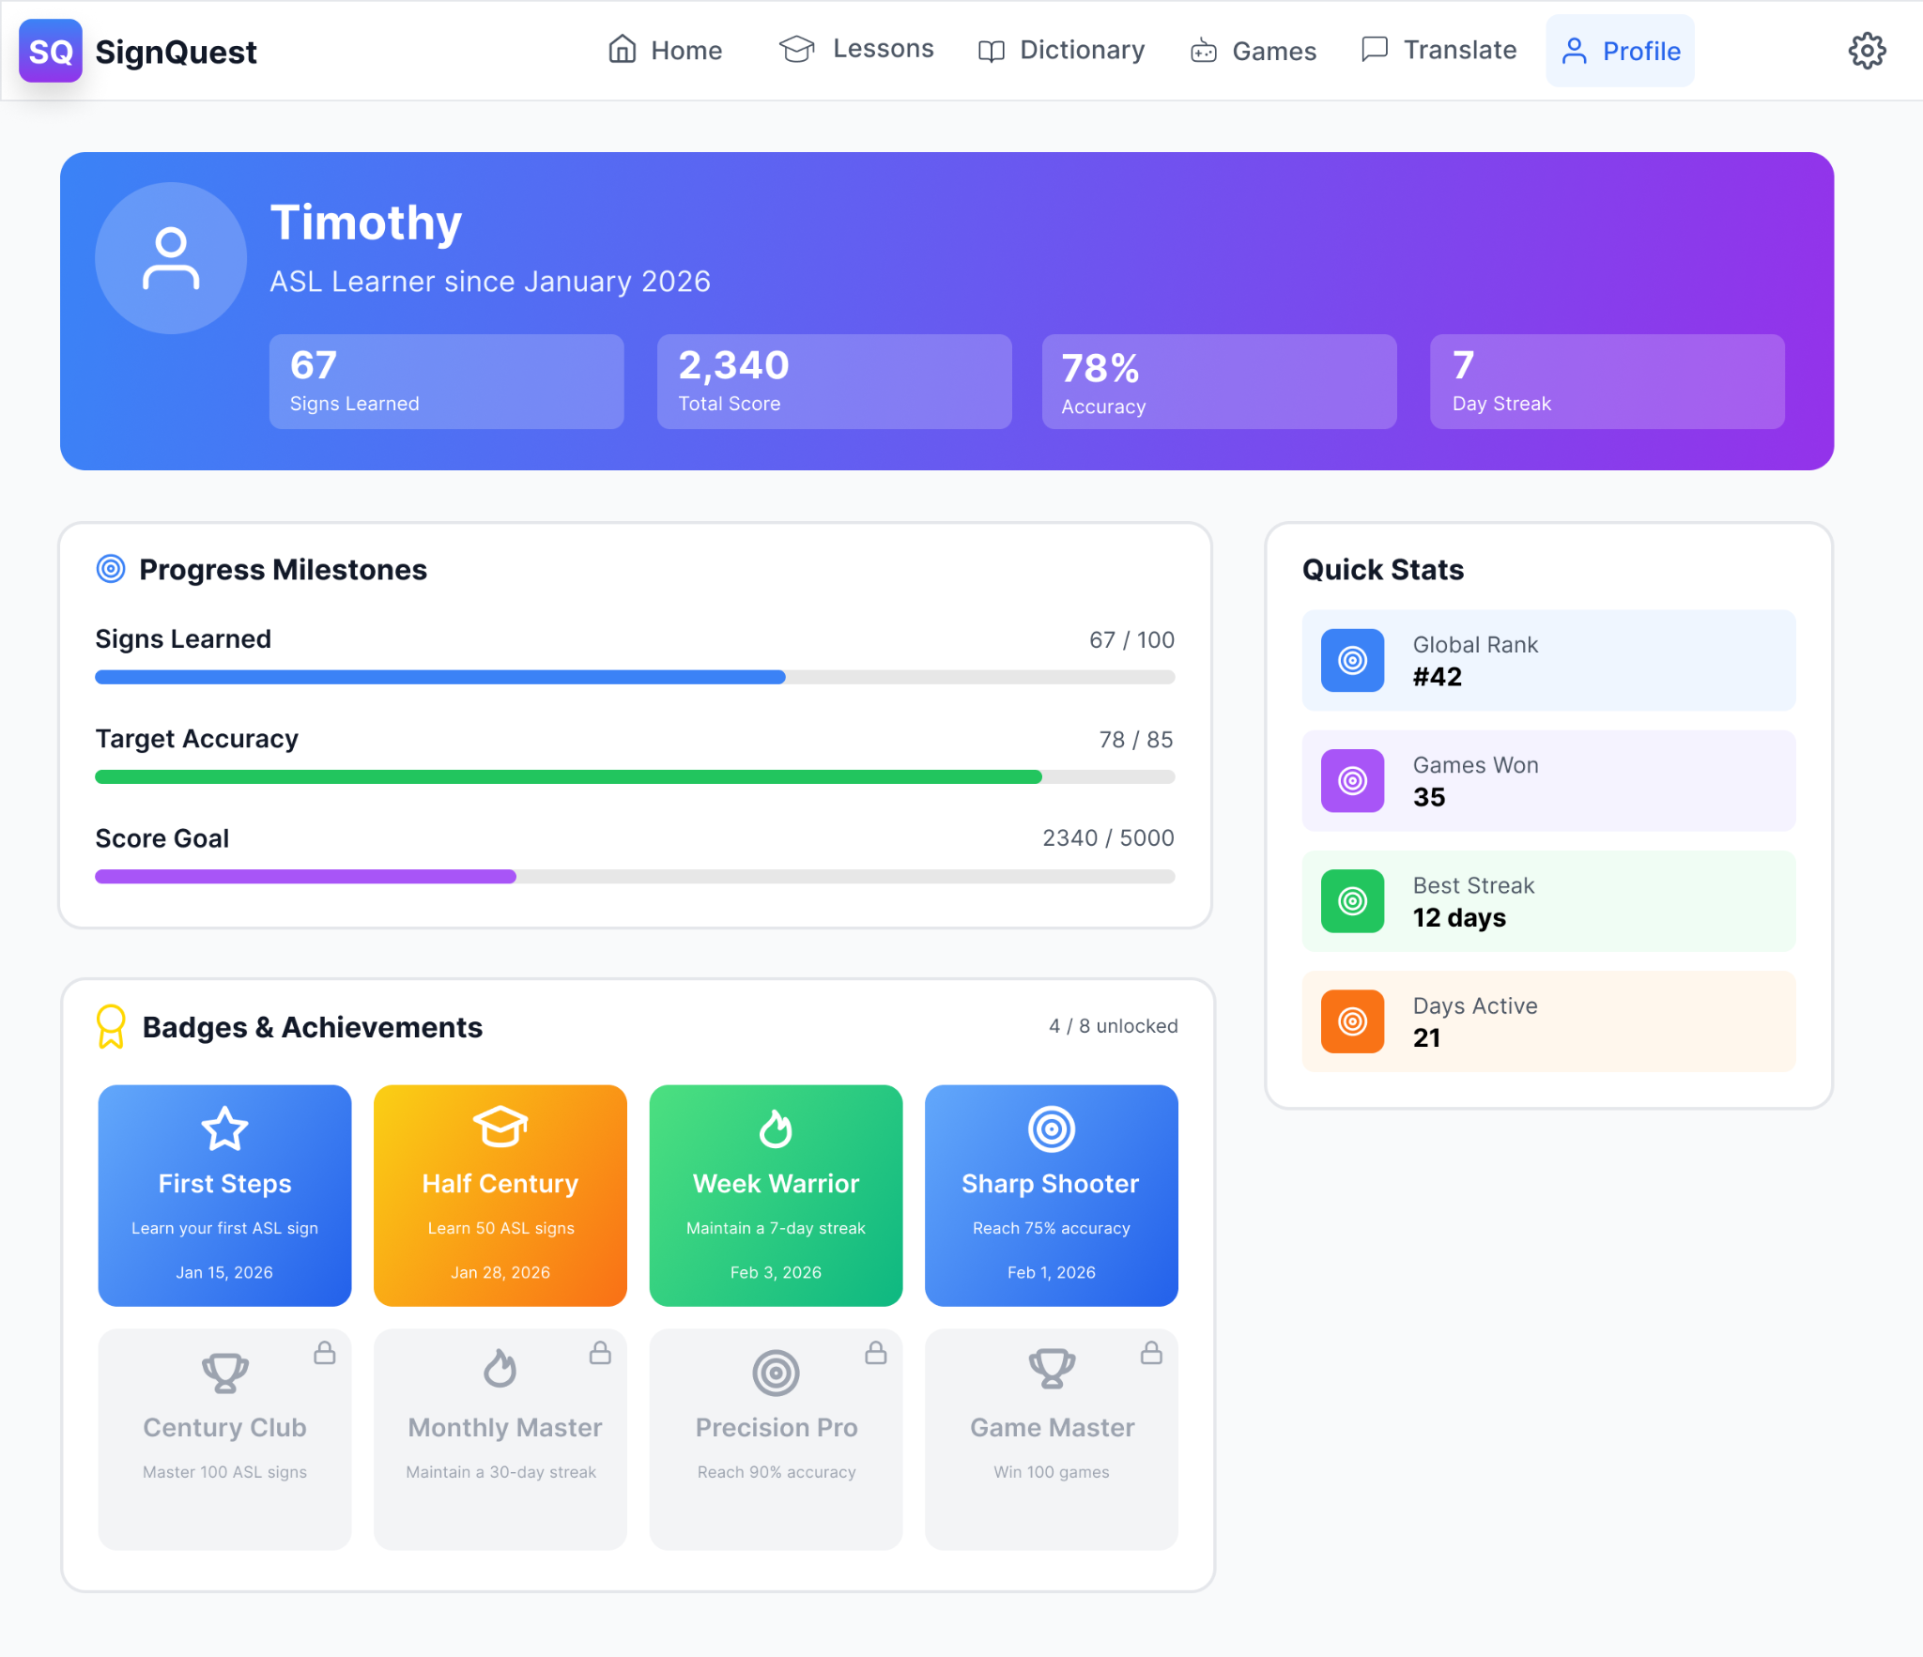
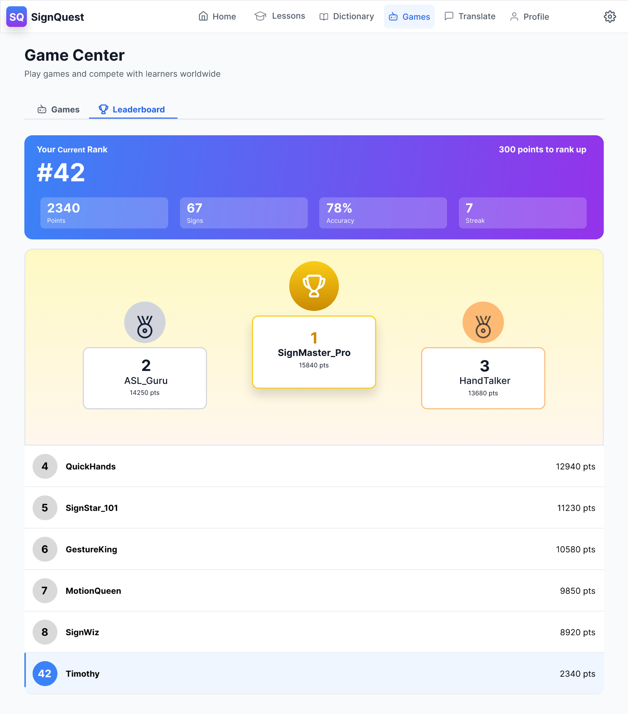
UI Design V2

Slide 21
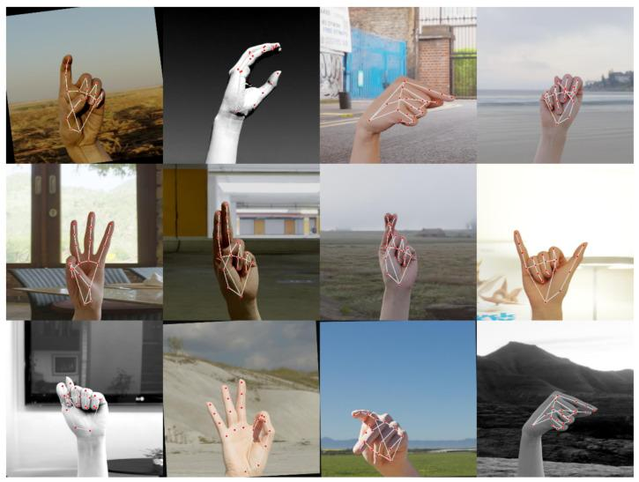
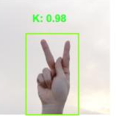
Technical Design
OpenCV
-> MediaPipe (BlazePalm Detector)
-> Hand Landmark Model
-> Output
-> YOLO
Notes:
The system captures video with OpenCV, detects hands using BlazePalm, extracts 21 keypoints with MediaPipe’s landmark model, and finally classifies the gesture into ASL letters or words using a neural network classifier.
OpenCV - Access to the camera
MediaPipe - Detect and tracking, Detects and tracks Hands
BlazePalm Detector, Detect Hand Helps detect palm and bounding box
Hand Landmark Model, Feature extraction With the YOLO model, this model is a pretrained CNN with the 21 detected keypoints.
YOLO Model Detect ASL Classified ASL letters and words using landmarks

Slide 22
References
[1] Wahyuningsih, A. 2024. A Systematic Review: The Use of Mobile Language Learning Apps to Improve Vocabulary. Journal of English as a Foreign Language Education (JEFLE), 5, 2 (2024), 13–20. https://jurnal.untan.ac.id/index.php/JEFLE/article/view/82996/756766043
[2] Hareesh Buddha, Liyana Shuib, Norisma Idris, and Christopher Ifeanyi Eke. 2024. Technology-assisted language learning systems: A systematic literature review. IEEE Access 12 (2024), 33449–33472. DOI: http://dx.doi.org/10.1109/access.2024.3366663
[3] Manitoba Education. 2020. Communication and Learning: A Resource Guide for Students Who Are Deaf or Hard of Hearing. Government of Manitoba, Winnipeg, MB, Canada. https://www.edu.gov.mb.ca/k12/docs/support/dhh_resource/pdfs/communication.pdf
[4] Germanna Community College. 2023. American Sign Language Grammar Guide (ed. July 24 2023). Germanna.edu. https://germanna.edu/sites/default/files/2023-07/ASL%20Grammar%20Guide%20%28edit%207-24-23%29.pdf
[5] Vanitha Thurairasu. 2022. Gamification-based learning as the future of Language learning: An overview. European Journal of Humanities and Social Sciences 2, 6 (November 2022), 62–69. DOI: http://dx.doi.org/10.24018/ejsocial.2022.2.6.353
[6]Zhanni Luo. 2023. The effectiveness of gamified tools for Foreign Language Learning (FLL): A systematic review. Behavioral Sciences 13, 4 (April 2023), 331. DOI: http://dx.doi.org/10.3390/bs13040331
[7] Bader Alsharif, Easa Alalwany, Ali Ibrahim, Imad Mahgoub, and Mohammad Ilyas. 2025. Real-time American Sign Language Interpretation using Deep Learning and keypoint tracking. Sensors 25, 7 (March 2025), 2138. DOI: http://dx.doi.org/10.3390/s25072138

